Slide 1

ELC Epidemiologist Orientation
Invasive and Respiratory Infectious Disease (IRID) Team
Lesley Brannan, MPH
DSHS Austin
February 23, 2016

Slide 2
Invasive and Respiratory Infectious Disease (IRID) Team - DSHS Austin EAIDB
Lesley Brannan, Epidemiologist 512-776-6354 (office); 512-284-1718 (cell)
IRID Team Leader
MERS, novel flu; outbreaks
Epidemiologist for all non-ILI/non-flu conditions
Influenza contracts, budget, planning, surge, special surveillance projects
Respiratory
Invasive
Johnathan Ledbetter, Epidemiologist
512-776-6223
State Influenza Surveillance Coordinator
Pediatric flu, novel flu, flu outbreaks
RSV
Robert “Bob” Russin, Public Health and Prevention Specialist
512-776-6242
Texas ILINet Coordinator
Assists with influenza and ILI surveillance
flutexas@dshs.texas.gov
Vacant, Epidemiologist I
Legionellosis
Meningococcal disease, invasive
Amy Littman, Public Health and Prevention Specialist 512-776-6339
Invasive Streptococcal diseases
Amebic meningitis/encephalitis (including PAM)
DSHS Emerging and Acute Infectious Disease Branch (EAIDB): Phone: (512) 776-7676, Fax: (512) 776-7616

Slide 3
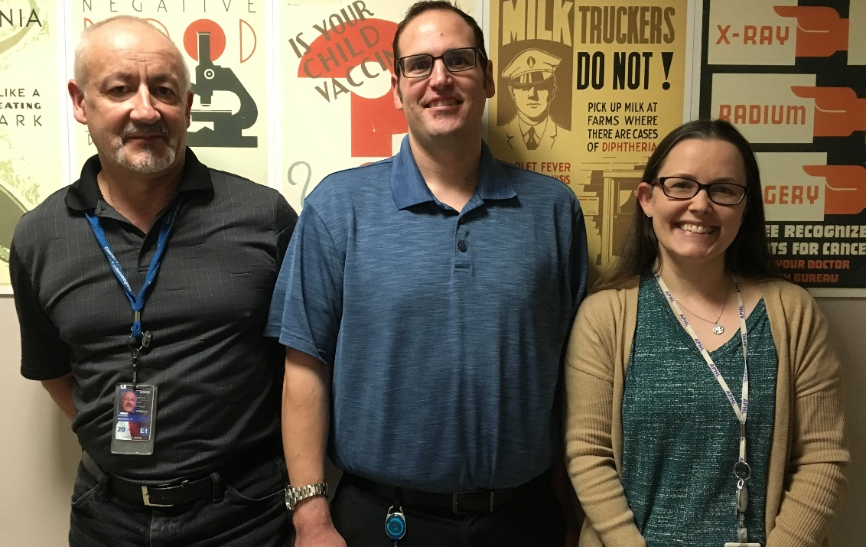


IRID Team
Bob
Johnathan
Lesley
Amy
??????

Slide 4
Condition | Reporting Timeframe | Investigation Form Required | Specimens/isolates required to be sent to DSHS | EAIDB Primary Contact(s) | Additional EAIDB Backup Contact(s)
Meningococcal disease, invasive | Immediately | Yes | Yes, isolates and specimens from purpuric lesions required by law | PHPS III-vacant, Lesley Brannan | Johnathan Ledbetter, Rachel Wiseman
Novel coronavirus | Immediately | Yes, for C or P cases, or anyone tested for MERS | Not required by law; specimens should be sent to qualified public health lab if PUI criteria are met | Lesley Brannan, Johnathan Ledbetter | Marilyn Felkner
Novel/variant influenza infection | Immediately | Yes, for C or P cases, or anyone tested for novel flu | Not required by law; specimens should be sent to DSHS or an LRN lab if CUI criteria are met | Johnathan Ledbetter, Lesley Brannan | Marilyn Felkner
Influenza-associated pediatric mortality | 1 work day | Yes | Not required by law; upper respiratory and tissue specimens requested for all cases | Johnathan Ledbetter | Lesley Brannan
Amebic meningitis/ encephalitis, including Primary Amebic Meningoencephalitis (PAM) | 1 week | Yes | Not required by law; specimens should be sent to CDC for confirmatory testing | Amy Littman, Lesley Brannan | Michael Fischer, Marilyn Felkner
Legionellosis | 1 week | Yes | No | PHPS III-vacant, Lesley Brannan | Johnathan Ledbetter, Keeley Morris
Streptococcus, Group A, invasive | 1 week | No | No | Amy Littman, Lesley Brannan | none
Streptococcus, Group B, invasive | 1 week | No | No | Amy Littman, Lesley Brannan | none
Streptococcus pneumoniae, invasive disease | 1 week | No | Not required by law; isolates requested on children <5 years old | Amy Littman, Lesley Brannan | Rachel Wiseman
Investigation forms: http://www.dshs.state.tx.us/idcu/investigation/

Slide 5
IRID Reportable Conditions
(non-flu)
Novel coronavirus/MERS
Invasive meningococcal infection
Amebic meningitis/encephalitis, including PAM
Legionellosis
Group A Streptococcus (invasive)
Group B Streptococcus (invasive)
Invasive pneumococcal disease

Slide 6
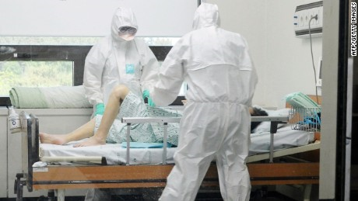
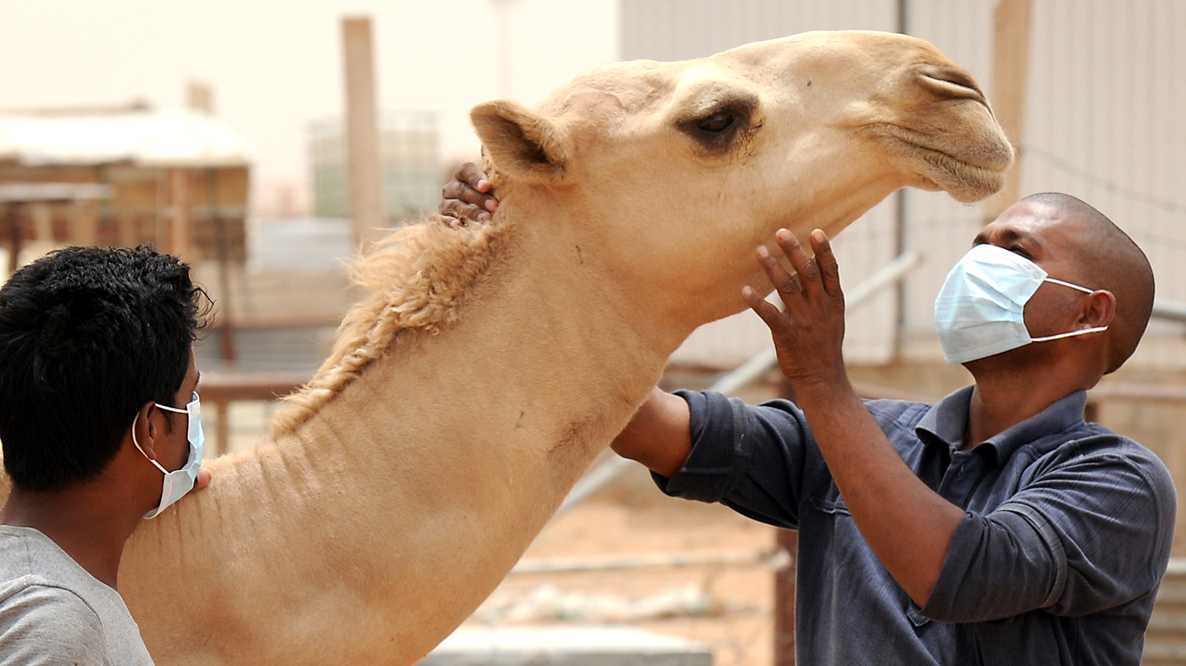
Novel Coronavirus
(MERS, SARS, etc.)
  Suspected cases immediately reportable
Middle East Respiratory Syndrome (MERS), 2012 to present
  1638 cases, 587 (36%) deaths
    2 cases in US (in 2014), none in TX
Transmission: not fully understood
  Animal to human: Direct or indirect contact with camels and their raw products
  Human to human: Close contact with infected persons, including via infectious respiratory secretions
Notes:
No SARS since 2004

Slide 7
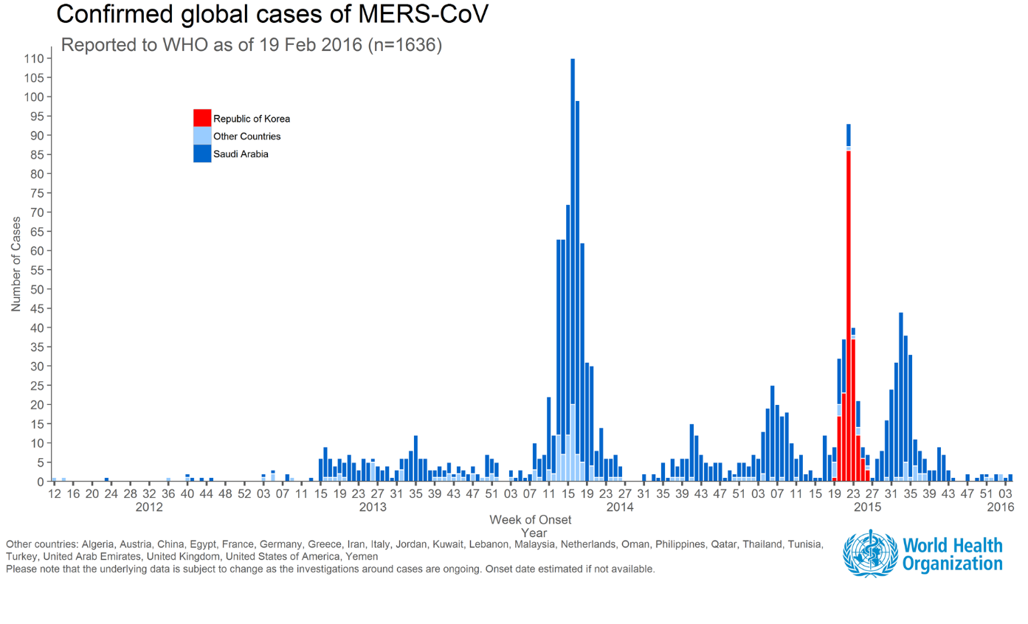
Republic of Korea
Republic of Korea outbreak
Other countries
2014
outbreaks in KSA, UAE
Saudi Arabia
Notes:
http://www.who.int/emergencies/mers-cov/en/

Slide 8
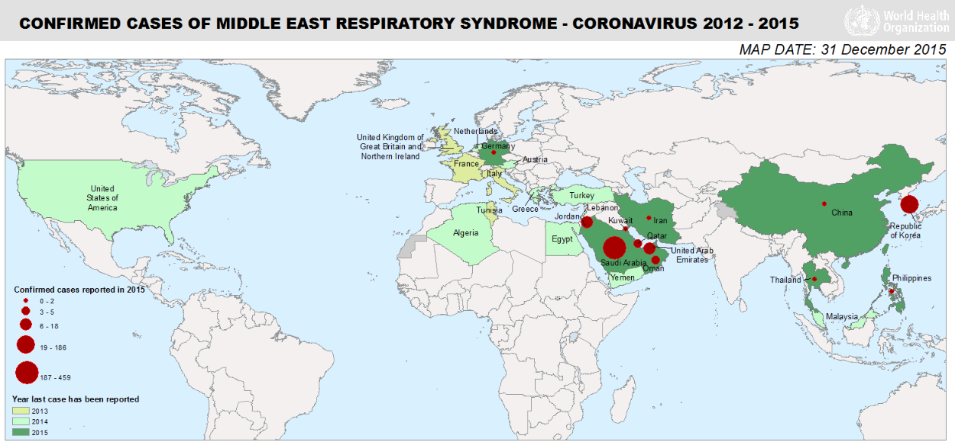
Countries in or near the Arabian Peninsula with MERS cases: Iran, Jordan, Kuwait, Lebanon, Oman, Qatar, Saudi Arabia, UAE, Yemen
Travel-associated MERS cases: Algeria, Austria, China, Egypt, France, Germany, Greece, Italy, Malaysia, Netherlands, Philippines, Republic of Korea, Thailand, Tunisia, Turkey, UK, USA
Notes:
http://www.who.int/emergencies/mers-cov/en/

Slide 9
MERS Disease
Incubation period: 2-14 days
Symptoms:
  Fever, cough, shortness of breath
  Pneumonia is common, but not always present
  Possibly GI symptoms
Clinical spectrum: asymptomatic/mild to severe
No vaccine, specific treatment, or chemoprophylaxis

Slide 10

MERS Risk Groups
Risk groups:
  Infection:
    Recent travelers to Arabian Peninsula (AP)
    Close contacts of ill AP travelers
    Close contacts of confirmed MERS case
    Healthcare personnel not using recommended infection control precautions
    People with exposure to camels or raw camel products
  Severe disease:
    Those with diabetes; cancer; chronic lung, heart, and kidney disease; or weakened immune systems

Slide 11

When you get a call
It will happen on a Friday
Don’t panic
Ensure infection control measures are in place
  Standard, contact, and airborne precautions recommended
  Use CDC’s MERS infection control guidance: http://www.cdc.gov/coronavirus/mers/infection-prevention-control.html
Work with provider/ICP to evaluate the patient for testing
  Collect data on “MERS Patient Under Investigation (PUI) Short Form”
  Follow CDC’s MERS PUI criteria to decide on testing

Slide 12
Should you test?
Patients are assessed against CDC MERS Patient Under Investigation (PUI) criteria: http://www.cdc.gov/coronavirus/mers/case-def.html
Clinical Features |  | Epidemiologic Risk
Severe illness (Fever, and pneumonia or ARDS) | AND | Travel from countries in or near the Arabian Peninsula in the 14 days before onset OR Close contact w/symptomatic traveler w/fever + ARI within 14 days after traveling in/near Arabian Peninsula. OR A member of a severe respiratory illness cluster, etiology unknown, under investigation by PH for MERS
Milder illness Fever and respiratory illness | AND | Being in a healthcare facility (as a patient, worker, or visitor) in the 14 days before onset in a country or territory in or near the Arabian Peninsula w/recent healthcare-associated cases of MERS
Fever or respiratory illness | AND | Close contact w/confirmed MERS case while the case was ill

Slide 13
PUI Criteria - Definitions, etc.
Fever may not be present in some patients, such as those who are very young, elderly, immunosuppressed, or taking certain medications
“Close contact” is defined as:
  a) being within approximately 6 feet (2 meters) or within the room or care area for a prolonged period of time (e.g., healthcare personnel, household members) while not wearing recommended personal protective equipment (PPE), OR
  b) having direct contact with infectious secretions (e.g., being coughed on) while not wearing recommended PPE

Slide 14
Novel coronavirus / MERS – lab testing
If patient meets PUI criteria, collect specimens: http://www.cdc.gov/coronavirus/mers/guidelines-clinical-specimens.html
  Collect ALL of these:
    lower respiratory (e.g., sputum),
    upper respiratory (combined NP and OP swabs in same VTM vial), AND
    serum (not whole blood)
Get specimens to lab as early as possible
TX MERS testing: DSHS Austin, Dallas LRN, Houston LRN
  Notify lab before sending specimens
  Provide tracking number for shipment
  Same-day testing recommended for those who meet PUI criteria
Completed PUI short form required on persons tested for MERS-CoV

Slide 15
Other Considerations
Younger, healthier persons may be asymptomatic or mildly ill
Ask for detailed exposure information
  Length of time in country? Layover only?
  Types of activities?
  In a healthcare facility for any reason? Details?
  Traveled with anyone else? Know others who are ill?
  Camel contact? What kind?
PUI criteria will not catch all cases; use judgment

Slide 16
IRID Reportable Conditions
(non-flu)
Novel coronavirus/MERS
Invasive meningococcal infection
Amebic meningitis/encephalitis, including PAM
Legionellosis
Group A Streptococcus (invasive)
Group B Streptococcus (invasive)
Invasive pneumococcal disease

Slide 17
Meningococcal Infection, Invasive
Neisseria meningitidis, a Gram-negative diplococcus
Serogroups A, B, C, Y, W-135 and X can cause outbreaks
Meningitis is not the only clinical presentation
  Most common in TX:
    meningitis (48%)
    bacteremia/septicemia (34%)
    pneumonia (3%)
  TX trends: About 20-30 cases/year (10%-20% die); most common serogroups: B, C, Y
Suspected and confirmed invasive cases immediately reportable
  “Sterile Site and Invasive Disease” flowchart - Appendix A, EAIDB Investigation Guidelines
Green serogroups are vaccine-preventable

Slide 18
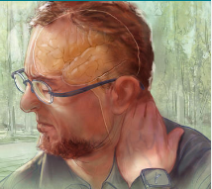
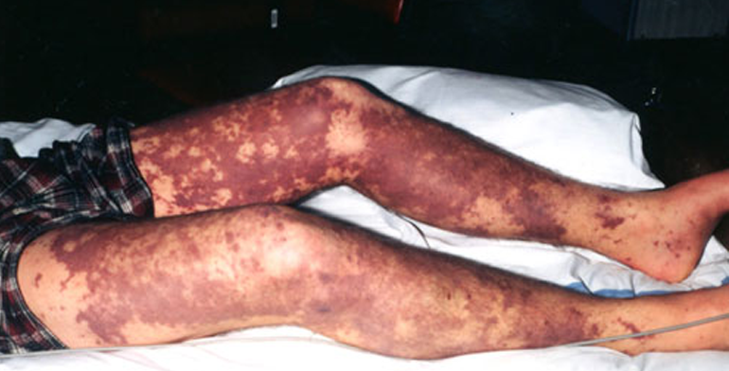
Meningococcal Case Investigation
Full case investigation for confirmed, probable, and suspected cases
  Complete the “Meningococcal Infection Investigation Form”
Identification and prophylaxis of close contacts (see AAP Red Book)
  Gram-negative diplococci or clinical purpura fulminans should trigger investigation; identification and prophy of close contacts
  Exposure window: 7 days before onset of disease in the case until the case has had 24 hours of effective antibiotic therapy

Slide 19
Important Data to Collect
Important for Immunization Grant deliverables
  Serogroup
  Vaccination status – check all sources!
  Patient outcome
  Investigate and report case within 30 days
Current CDC hot topic: MSM status and associated clusters
  3 new questions on the investigation form (coming early March 2016)

Slide 20
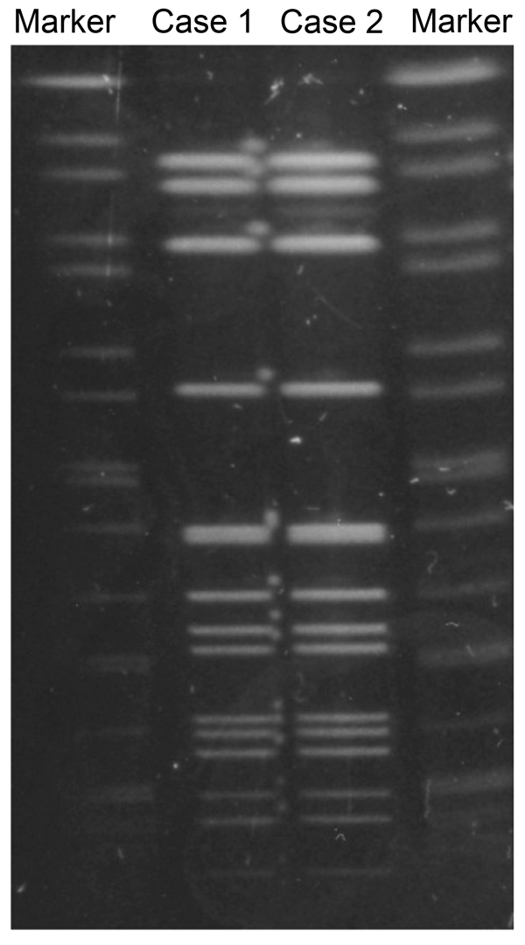
Neisseria meningitidis
Lab Testing and Requirements
Isolates required by law:
  From sterile sites and purpuric lesions
  Send to DSHS Austin Lab
Testing:
  DSHS Austin: Serotyping and PFGE
  PCR (ID and serotyping) can be done at CDC on:
    Non-viable isolates
    Clinical specimens (CSF, blood)
    Contact EAIDB to arrange testing

Slide 21
IRID Reportable Conditions
(non-flu)
Novel coronavirus/MERS
Invasive meningococcal infection
Amebic meningitis/ encephalitis, including PAM
Legionellosis
Group A Streptococcus (invasive)
Group B Streptococcus (invasive)
Invasive pneumococcal disease

Slide 22

Primary Amebic Meningoencephalitis (PAM)
Caused by Naegleria fowleri, a free-living amoeba
Probably underreported/under recognized (rapid time to death)
Transmission:
  Water contaminated with amoeba is forced up nose (diving, swimming, sinus rinse, etc.)
  Maybe organ transplantation (not documented)
Risk groups:
  Unknown/potentially anyone
  Most cases in younger persons, particularly boys
  People who perform nasal irrigation or sinus rinses with non-sterile or non-distilled water
TX trends: 7 cases from 2006-2015
  Average age: 12 years

Slide 23
PAM Diagnosis
Symptoms: severe frontal headache, fever, nausea, vomiting, stiff neck, seizures, altered mental status, hallucinations, coma
Incubation period: 1-9 days (median 5 days)
Death: 1-18 days (median 5 days) after onset
Testing:
  Amoebae seen in wet mount of CSF
  CDC confirms diagnosis and etiology, typically by PCR

Slide 24
PAM Cases – Prevention and Response
Avoid:
  Activities that may force water up the nose
  Activities that disturb amebae in the environment
  Water activities in warm freshwater when it’s hottest outside
Use nose clips, hold your nose, or keep your head above water
Use only sterile, distilled, or boiled (and then cooled) water for sinus irrigation
Testing of untreated rivers and lakes for N. fowleri is generally not recommended
No public health criteria for acceptable or unacceptable amoeba levels in water
  Posting signs at bodies of water with detections or cases may be misleading
Notify your press office
  PAM cases often make the news
Notes:
Recommendations for general public: http://www.cdc.gov/parasites/naegleria/prevention.html; http://www.cdc.gov/parasites/naegleria/materials.html
Other things to know: http://www.cdc.gov/parasites/naegleria/swimming.html
Testing of untreated rivers and lakes for N. fowleri is generally not recommended
No public health criteria for what levels of amebae in water are acceptable or unacceptable
Posting signs based on finding N. fowleri in the water is unlikely to be an effective way to prevent infections

Slide 25
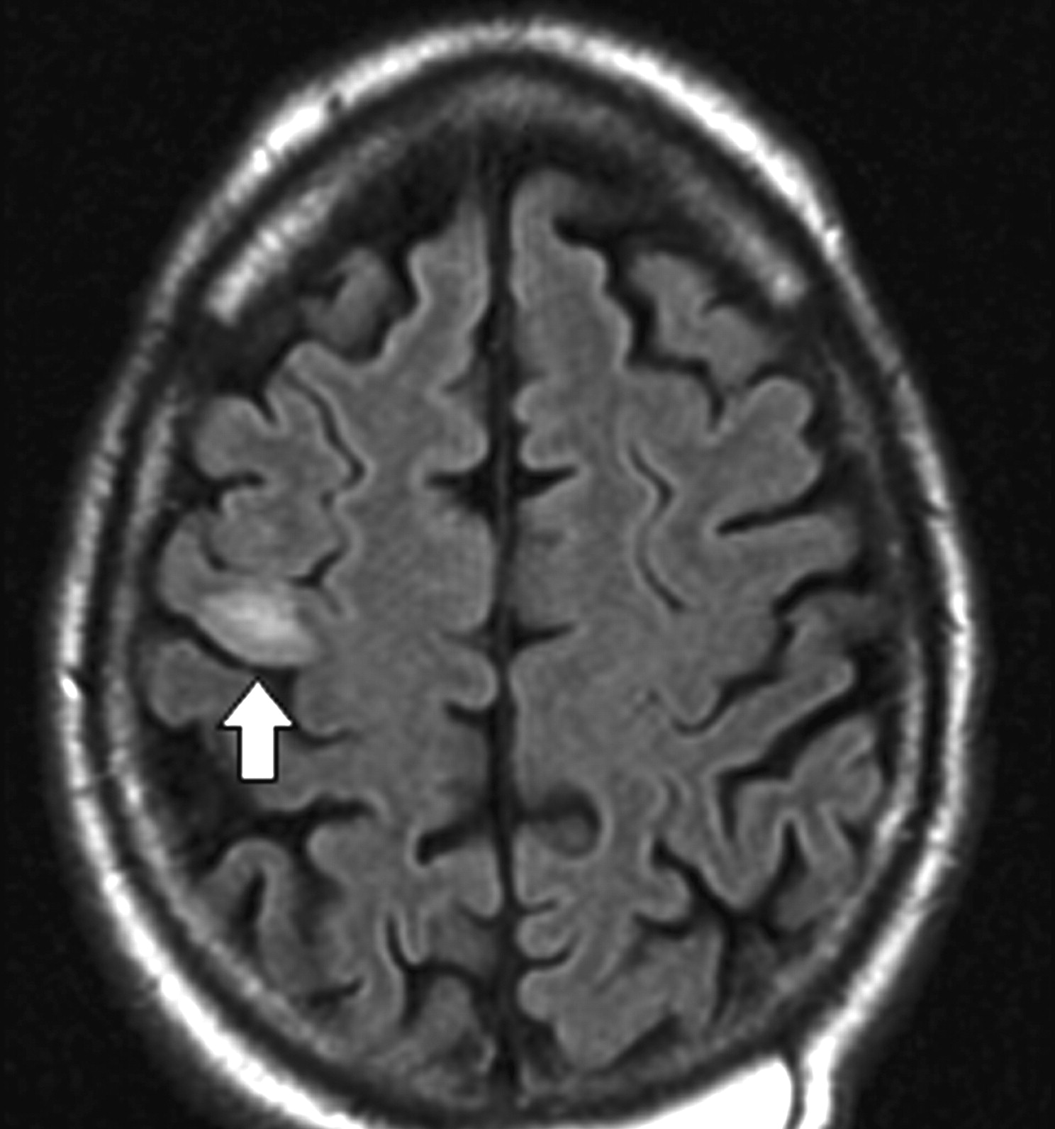
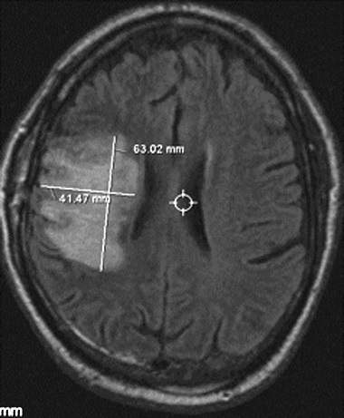
Amebic Meningitis/Encephalitis,
Other than PAM
Granulomatous Amebic Encephalitis (GAE) caused by
Balamuthia, Acanthamoeba spp.
Definitely underreported/under recognized
Transmission: when soil (and possibly water) contacts skin or wounds,
inhaling dust, organ donation/transplantation
Incubation period: weeks to months (and even years)
Signs/Symptoms: may begin with skin wound, then headaches, stiff neck, photophobia, N/V, lethargy, fever, behavioral changes, seizures, weight loss, partial paralysis, difficulty speaking, difficulty walking
Risk groups:
  Acanthamoeba: immunocompromised
  Balamuthia: anyone can be infected; at greater risk are people with
  chronic conditions or weakened immune systems
Prevention/control: nothing specific
TX trends: 5 cases from 2006-2015 (4 Balamuthia, 1 Acanthamoeba)
Notes:
Age range: 5 years to 77 years

Slide 26
For all amebic CNS infections
Investigate all suspected or confirmed cases
  Complete the “Free-Living Ameba Case Report” form
  Be as thorough as possible – still a lot of unknowns, few cases
    Get medical records
    Interview family
    Collect thorough exposure history (water/soil exposures, wounds, travel hx), disease progression, findings
  Determine whether organs/corneas were donated
Investigational treatment: miltefosine
  Request through CDC’s EOC

Slide 27
IRID Reportable Conditions
(non-flu)
Novel coronavirus/MERS
Invasive meningococcal infection
Amebic meningitis/encephalitis, including PAM
Legionellosis
Group A Streptococcus (invasive)
Group B Streptococcus (invasive)
Invasive pneumococcal disease

Slide 28
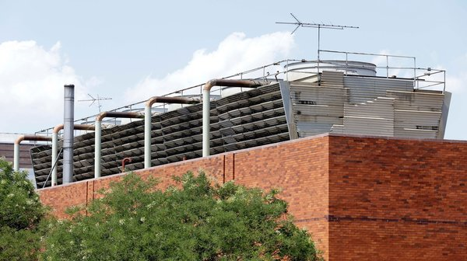

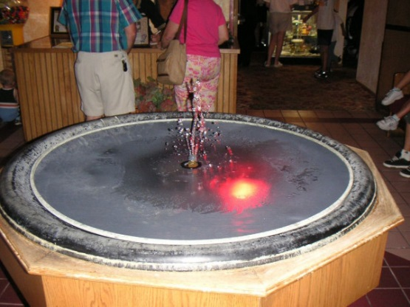
Legionellosis
Legionella bacteria live in water (primarily) and soil; live inside protozoa
Favorable conditions:
  Stagnant water (dead legs in plumbing)
  Warmer water (prefers: 77F-108F)
  Presence of organic matter
  Absence of residual disinfectant
Transmission/infection:
  Legionella can be a problem in manmade water systems
  Need amplification, aerosolization (or aspiration), and infection of susceptible host
    e.g., cooling towers, hot tubs, decorative fountains, faucets/showerheads, ice chips, etc.
  Occasionally acquired from (potting) soil exposure (L. longbeachae)
  No person-to-person transmission
Risk groups: ≥50yo, current/former smokers, people with chronic lung disease, weak immune system (cancer, diabetes, or kidney failure), or take immunosuppressing drugs
TX trends: cases increasing each year in TX
Notes:
Below 77F they do not grow but they do not die; they can wait for more favorable conditions
They can survive up to 158F

Slide 29
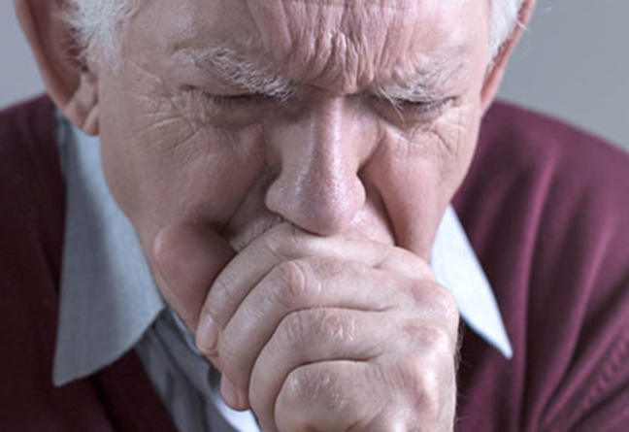
Reporting and Investigation
Legionellosis includes Legionnaires’ disease (pneumonia) and Pontiac fever (milder, flu-like)
Main purpose of case investigation is to identify potential exposures to interrupt transmission
  Interview patient or surrogate
  Supplement interview with medical records
  Obtain specific info on exposures during the 10-day incubation period
    Hotel/facility information—full name and address, dates of stay, potential exposures, room numbers/locations, etc.
    Exposures to aerosolized or aspirated water
Complete “Legionellosis Investigation Report Form”

Slide 30
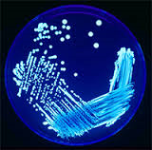
Legionella – Clinical Laboratory testing
Legionella pneumophila serogroup 1 (Lp1) estimated to cause 85% of human cases
Lab confirmation requires one of these:
  Culture positive for ANY Legionella species
    Important for outbreaks (link clinical & environmental samples)
  Urinary antigen test positive
    Detects Lp1*
    Most common test type
  Seroconversion by a fourfold or greater rise in specific serum antibody to Lp1

Slide 31
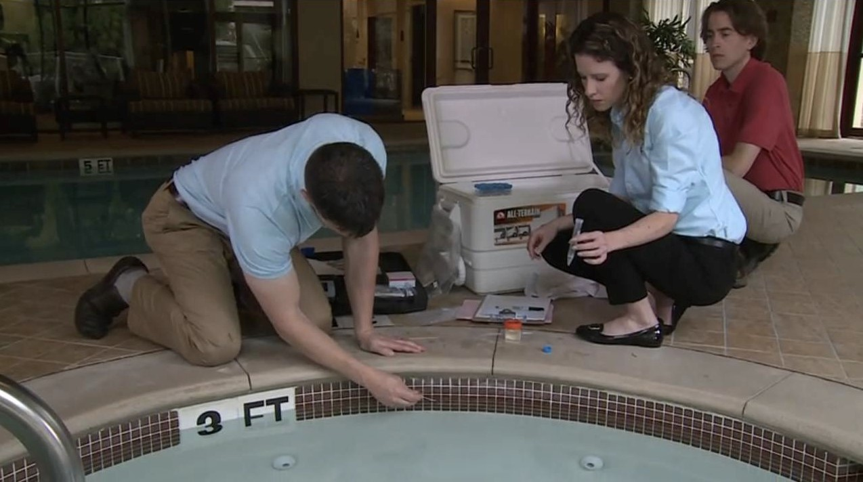
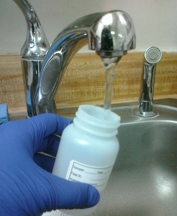
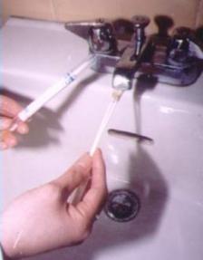
Legionellosis outbreaks
Exposures reported by cases are tracked to detect clusters/outbreaks in healthcare facilities, hotels, communities, etc.
Outbreak investigations
  Often complex
  Active case finding and dual testing (UA, culture)
  Thorough case investigation and complete environmental assessment are essential
  Facility should hire a competent Legionella consultant
    Assessment, sampling/testing, remediation
  Environmental lab testing (looking for Legionella in bulk water samples, biofilm swab samples) only done at private labs in Texas
    Recommend using ELITE-certified lab

Slide 32
IRID Reportable Conditions
(non-flu)
Novel coronavirus/MERS
Invasive meningococcal infection
Amebic meningitis/encephalitis, including PAM
Legionellosis
Group A Streptococcus (invasive)
Group B Streptococcus (invasive)
Invasive pneumococcal disease

Slide 33
Group A Streptococcus (GAS), Invasive
Streptococcus pyogenes, a bacterium
What’s reportable: suspected and confirmed invasive cases (sterile sites only, except for necrotizing fasciitis or streptococcal toxic shock syndrome)
Disease: invasive (e.g., bacteremia, NF, STSS) and noninvasive (e.g., strep throat)
Increased risk of disease: persons with chronic illnesses; use of steroid medications; people with skin lesions (such as cuts, chickenpox, or surgical wounds); elderly; adults with a history of alcohol abuse or injection drug use

Slide 34
Group B Streptococcus (GBS), Invasive
Streptococcus agalactiae, a bacterium
What’s reportable: suspected and confirmed invasive cases (from sterile sites, or placenta or amnion/amniotic fluid)
GBS bacteria can cause:
  Newborns: sepsis, pneumonia, meningitis
    Early-onset disease: Occurs during the first week of life
      Prevention program: test pregnant women for GBS carriage at 35-37 weeks gestation; antibiotics during labor if indicated
    Late-onset disease: Occurs from the first week through three months of life
  Adults: bloodstream infections; pneumonia; skin and soft-tissue infections; bone and joint infections; meningitis (rare)

Slide 35
Streptococcus pneumoniae, Invasive
(Invasive Pneumococcal Disease [IPD])
Streptococcus pneumoniae, a bacterium
What’s reportable: suspected and confirmed invasive cases (sterile sites)
Can cause ear infections, sinus infections, meningitis, bacteremia, and pneumonia
Increased risk for pneumococcal disease:
  Children: < 2 years old; in group child care; persons with certain illnesses (sickle cell disease, HIV infection, or chronic heart or lung conditions); persons with cochlear implants or CSF leaks; and/or of American Indian, Alaska Native, or African American race
  Adults: ≥65 years old; smokers; chronic illnesses or immunocompromised; residents of nursing homes/LTCFs; and/or persons with cochlear implants or CSF leaks
Vaccines available: PCV13 for infants, children, and adults; PPSV23 for children and adults

Slide 36
TX Invasive Streptococcal Disease Cases, 2006-2015*

Slide 37
Invasive Streps - Investigation
Public health follow up:
  Investigate all reports of suspected invasive GAS, GBS, S. pneumo
    Must collect enough information to confirm the case status
    For S. pneumo, must obtain vaccine status and patient outcome
    Do not have to interview patient
    Do not have to send form to DSHS Austin
  Be alert for clusters (facility, community, etc.)
Resources:
  Flowcharts in Appendix A of EAIDB Investigation Guidelines
    Sterile Site and Invasive Disease Determination
    Streptococcal Infection Case Status Classification
  Streptococcus Classification description in the Epi Case Criteria Guide

Slide 38
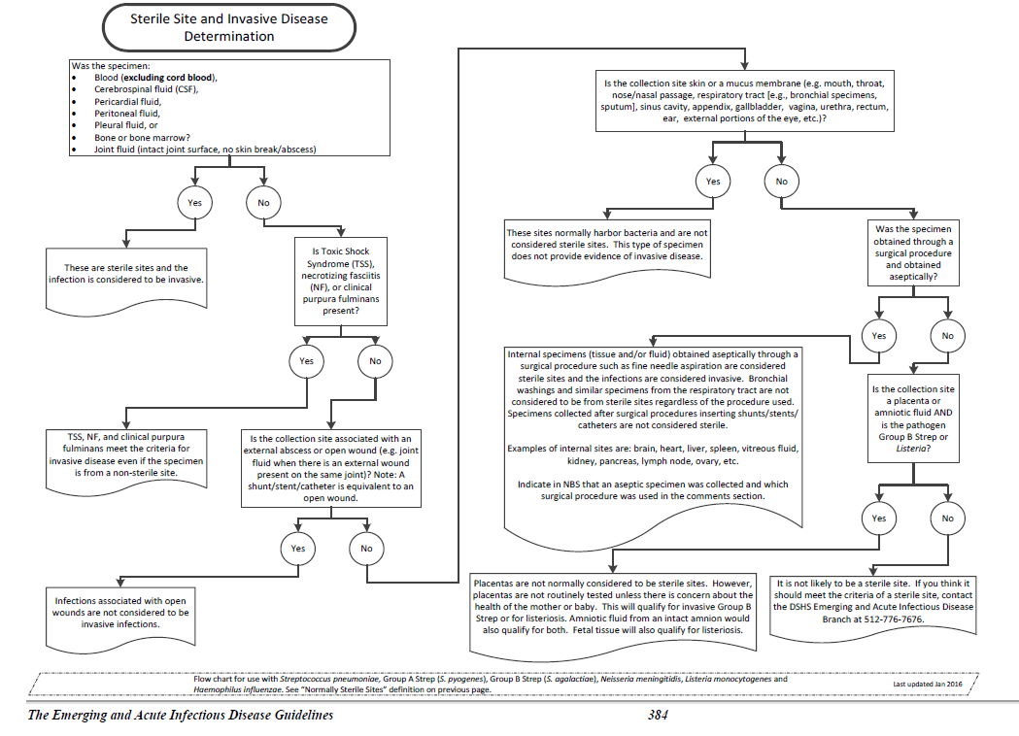

Slide 39
Laboratory – Invasive Streps
Initial testing typically done by hospital or commercial labs
For suspected clusters, DSHS Austin can perform PFGE (molecular) testing to determine relatedness
S. pneumoniae serogrouping project (**VOLUNTARY**)
  Send these isolates to DSHS (we send to MN)
    Sterile sites only
    Isolates from kids <5 years of age
  Shipping costs not covered and cannot be reimbursed
  Testing costs are covered

Slide 40

Influenza,
ILI, and Respiratory Virus Surveillance
You don’t understand the power of the flu

Slide 41
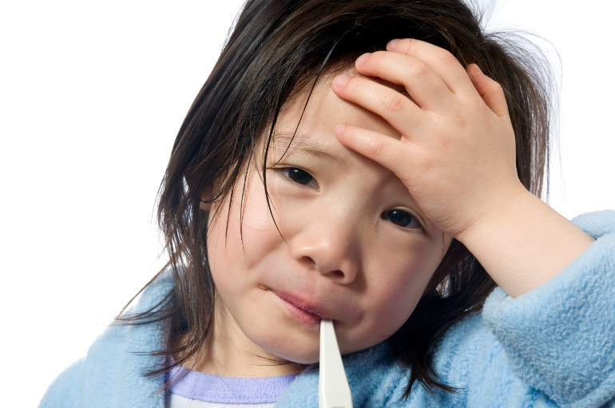
Influenza
Current flu viruses seen in humans:
  Influenza A subtypes H1N1 and H3N2
  Influenza B
Annual disease burden estimates:
  5%-20% of US population gets the flu
  200,000+ hospitalizations
  23,000+ deaths
What’s reportable in TX:
  Influenza-associated pediatric deaths
  Novel/variant influenza A infections in humans
  Outbreaks

Slide 42
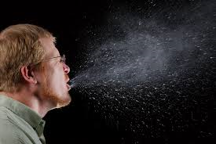
Flu Prevention and Control
Annual vaccination for ages 6 months and older
Antiviral prophylaxis (recommended for persons at risk of severe disease, including outbreaks in LTCFs and hospitals)
Non-pharmaceutical interventions (e.g., wash hands, cover your cough, stay home when sick, avoid ill persons, etc.)
Infection control: standard and droplet precautions
Outbreak-specific recommendations: cohort ill patients/residents, exclude ill staff from work, limit movement of visitors, post signs, active surveillance, etc.
  http://www.cdc.gov/flu/professionals/infectioncontrol/healthcaresettings.htm
  http://www.cdc.gov/flu/professionals/infectioncontrol/ltc-facility-guidance.htm

Slide 43
Texas Influenza Surveillance Components
Morbidity
  Influenza-like illness (ILI) cases (ILINet and reports to LHDs/HSRs)
  Influenza illnesses
  Novel/variant influenza A infections in humans
  Outbreaks
  Absenteeism
  Syndromic surveillance
Mortality
  Influenza-associated pediatric mortality
  Pneumonia and influenza (P&I) deaths (from DSHS vital stats)
  Proposed: all influenza-associated deaths (estimated in 2017-2018)
Virologic
  CDC NREVSS (hospital labs)
  DSHS Austin and LRN labs (PCR testing)

Slide 44
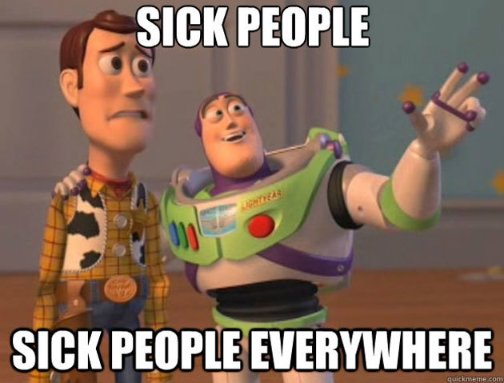
Current Flu Summary

Slide 45
TX Current Flu Summary (Feb 22, 2016)
Flu and ILI activity are increasing across the state
  Peak? Too early to say
    According to a prediction model, TX peak may be in March
Influenza A 2009 H1N1 is predominant strain
  Initially, A H3N2 predominated
  Influenza B also circulating
Good news! Circulating viruses are similar to vaccine strains
Beginning to get reports of ILI/flu outbreaks
  Schools
  LTCFs
No confirmed influenza-associated pediatric deaths reported
Other respiratory viruses also circulating, especially rhinovirus/enterovirus and RSV

Slide 46
Influenza-Associated Pediatric Mortality
What’s reportable: Deaths in children <18 years of age that are suspected or confirmed to be associated with influenza illness
  Count case unless there is an alternative cause of death that is not related to an infectious process (e.g., car accident)
  Must have a positive influenza test, but all positive flu tests count (including point-of-care rapid tests) toward case definition
CDC reporting goal: within 2 weeks of death
CDC wants specimens from all cases
Complete the “Influenza-Associated Pediatric Mortality Case Report Form”
  Obtain flu vaccine history (often missing)

Slide 47
What is novel/variant influenza?
Influenza A subtypes that do not normally circulate in humans
  e.g., avian and swine strains—H5, H7, H3N2v, etc.
What’s reportable: any suspected or confirmed novel/variant flu case
Public health role:
  Suspected cases: investigate, evaluate for testing, ensure infection control
  Confirmed or probable cases:
    (Human) case investigation including contact tracing to prevent further cases
    Animal investigation (if applicable) - TAHC

Slide 48
If you get a call
Ensure that infection control precautions are in place: standard, contact, and airborne recommended: http://www.cdc.gov/flu/avianflu/novel-flu-infection-control.htm
Work with providers to evaluate patients for suspected novel/variant flu:
  Record information on the “General Influenza Investigation Form” and “Influenza Investigation Form Supplemental Pages”
  Use the CDC’s Case Under Investigation (CUI) criteria and/or consult with DSHS:
    H5N1: http://www.cdc.gov/flu/avianflu/h5n1/case-definitions.htm
    H7N9: http://www.cdc.gov/flu/avianflu/h7n9/case-definitions.htm
    HPAI H5: http://www.cdc.gov/flu/avianflu/hpai/case-definitions.htm
  CUI/PUI criteria requires 1) compatible illness AND 2) exposure criteria

Slide 49
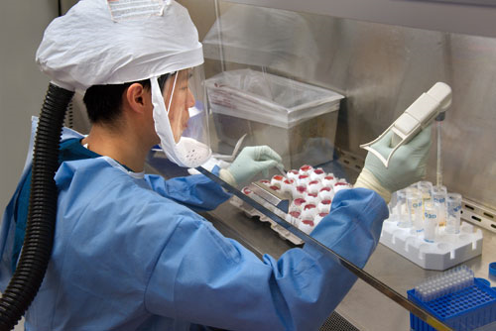
Lab testing for novel flu
If patient meets CUI/PUI criteria, collect specimens
  Upper respiratory symptoms: upper respiratory swab
    (e.g., NP swab in VTM, nasal aspirate/wash, or combined NP/OP swabs in VTM)
  Lower respiratory tract specimen may be preferred if patient has lower respiratory tract illness
  If other symptoms (e.g., eye irritation), may need additional samples (e.g., conjunctival)
Novel/avian flu testing in TX: DSHS Austin and all Texas LRNs
  Notify lab before sending specimens
  Provide tracking number for shipment
  Same-day testing recommended for those who meet CUI/PUI criteria

Slide 50
Flu testing FAQs
The hospital can do influenza testing (antigen, PCR, culture, etc.). Why should I send this suspected novel /avian flu specimen to DSHS or an LRN?
  Culture is a no-no
  Antigen tests results are unreliable and cannot subtype
  PCR tests are not created equally
    Public health labs in TX run CDC’s PCR flu assay
    Other flu PCR assays may not detect novel strains
Patient doesn’t meet CUI/PUI criteria (but hospital still wants him tested / I’m still concerned). What do I do?
  Can still test patient at DSHS Austin or LRN using seasonal flu RT-PCR assay (will also detect novel strains)
  No testing urgency with non-CUIs/PUIs

Slide 51
Novel/Variant Influenza - Humans
 | H5N1* | H7N9*
Cases [n] | 846 | 693
Deaths [n (%)] | 449 (53%) | 277 (40%)
Median Age (Age Range) | 18 years† (0-86 years) | 58 years† (0-91 years)
% Male Sex | 46.9%† | 68.5%†
First onset | 2003 | 2013
Last onset | Dec 2015 | Jan 2016
Countries with human cases | 16 (Asia, M.E., Africa, Canada) | 3 (China, Malaysia, Canada)
Exposure(s) | Poultry | Poultry/ bird markets
†Qin, Ying, et al. "Differences in the epidemiology of human cases of avian influenza A (H7N9) and A (H5N1) viruses infection." Clinical Infectious Diseases (2015): civ345.
*As of 1/20/16
Notes:
http://www.who.int/influenza/human_animal_interface/Influenza_Summary_IRA_HA_interface_20_Jan_2016.pdf?ua=1

Slide 52
Number of Confirmed Human H5N1 Cases by Month of Onset, Worldwide (as of 7/6/2015)

Slide 53
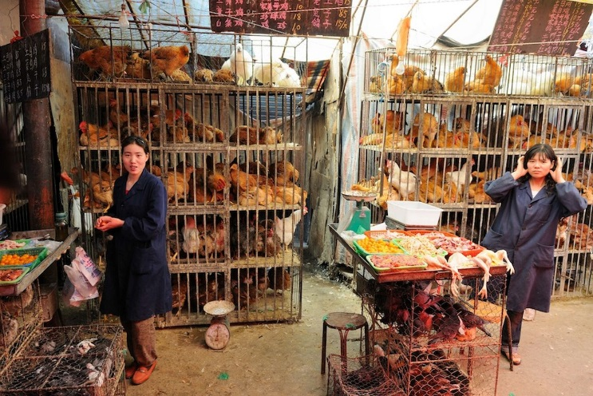
Number of Confirmed Human H7N9 Cases by Week of Onset, Worldwide (as of 11/13/2015)

Slide 54
Recent Human Infections with Other Novel Influenza Viruses
Avian viruses
  H5N6 – 10 cases, 9 severe (including 6 deaths) in China
  H9N2 - Bangladesh
Swine viruses
  H1N1v – 3 in 2015 (OH, IA, MN)
  H3N2v - 3 infections in 2015 (MI, MN, NJ)
No novel/avian/swine cases in humans in TX since 2010!

Slide 55
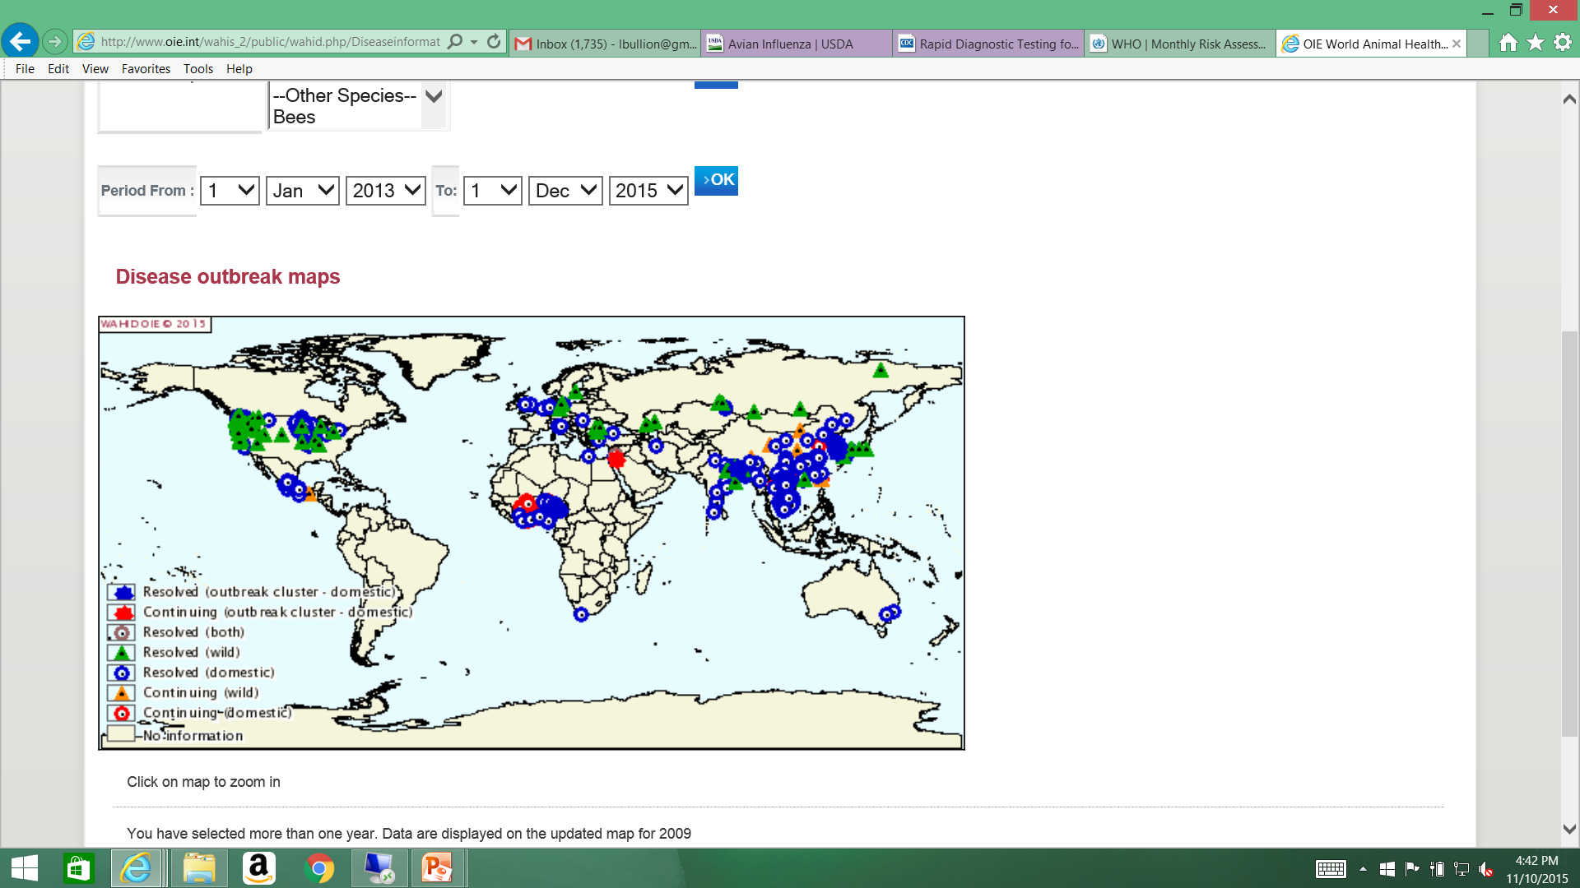
HPAI (H5, H7) Animal Outbreaks, 2015
(as of 11/10/15)

Slide 56
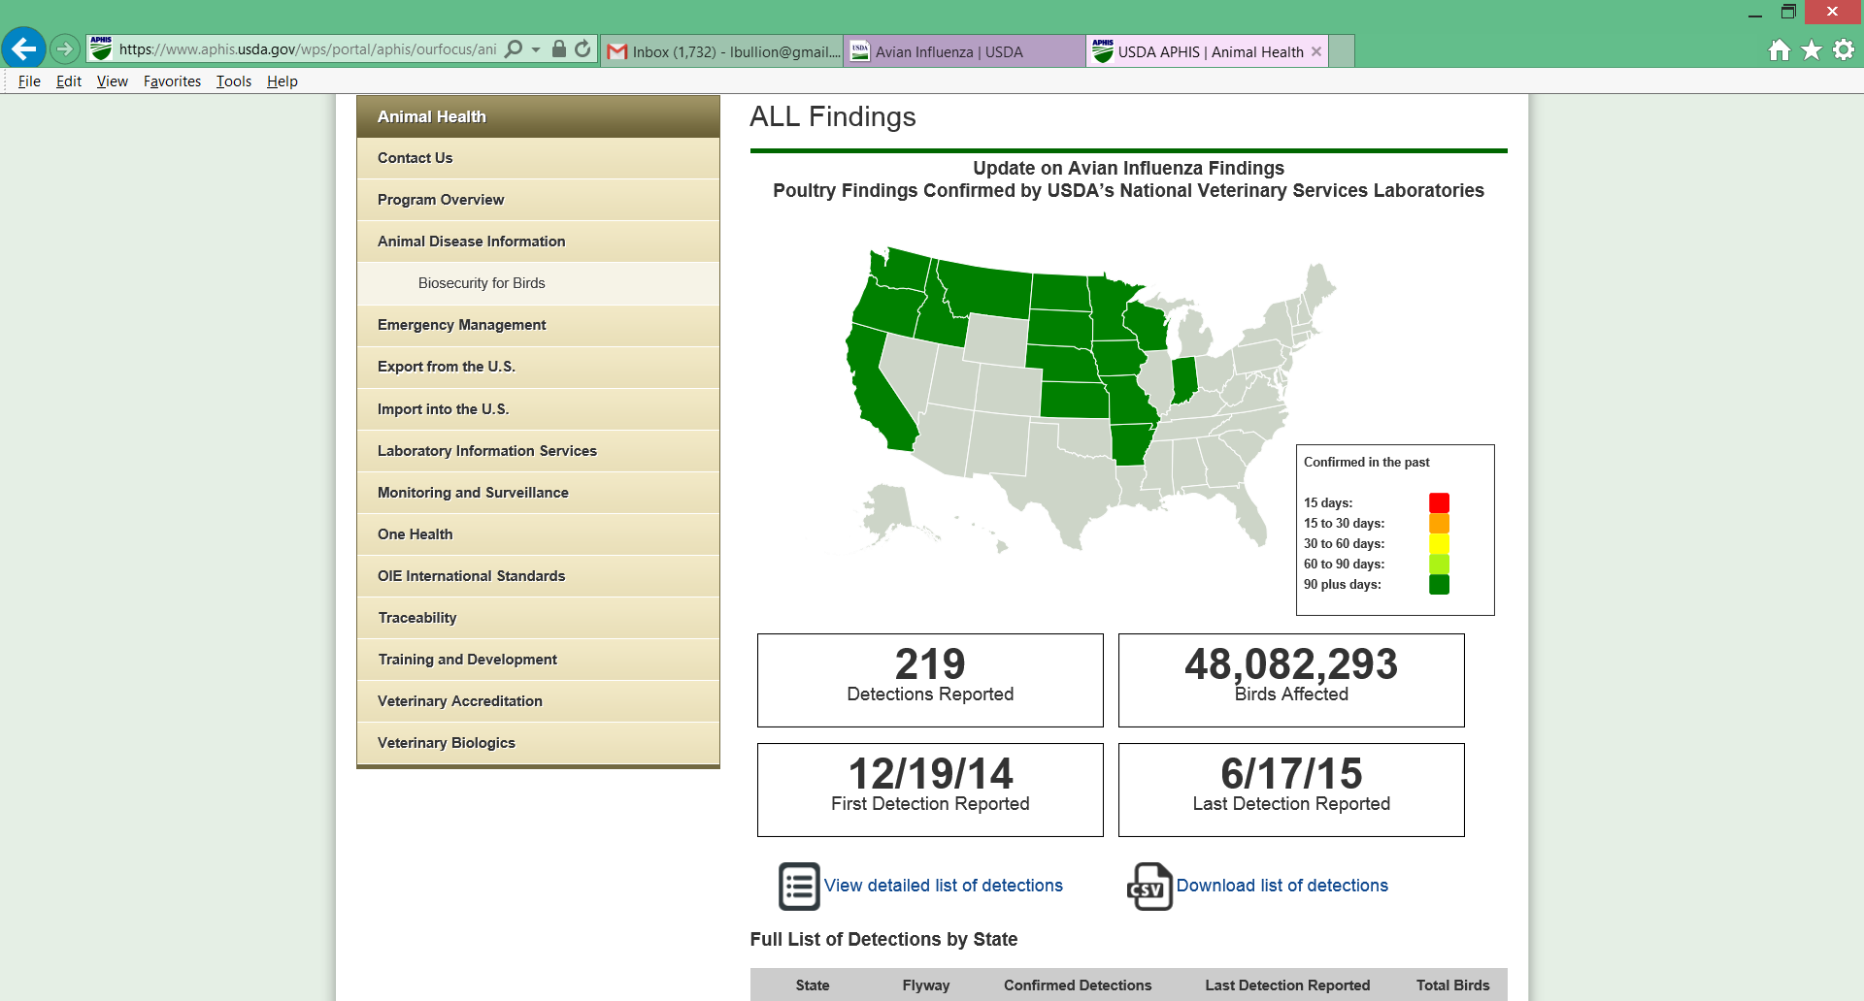
Avian Flu in the US
2015 HPAI H5N2, Dec 2014—Jun 2015
  Started with wild birds in WA
  15 states affected
    Commercial poultry premises
    Backyard flocks
    Wild birds
  No human H5N2 cases detected
2016 HPAI and LPAI H7N8
  Turkey flocks in Dubois Co, Indiana – Jan 2016
  No human H7N8 cases detected
https://www.aphis.usda.gov

Slide 57
ILINet
US Outpatient Influenza-like Illness Surveillance Network (ILINet)
Voluntary nationwide network of outpatient providers who report weekly on number of patients seen with influenza-like illness (ILI) by age group, and total patients seen for any reason
  Can calculate % ILI
  ILI definition: fever ≥ 100°F plus cough and/or sore throat
CDC recruitment target: 1 provider per 250,000 population
  Providers urgently needed in Regions 1 and 4
  Provider participation takes about 20 minutes/week
  Contact Robert Russin to enroll providers
Only non-lab flu surveillance system to “detect” the start of the 2009 pandemic
To log in to the online system to see data from Texas, contact Robert Russin

Slide 58
NREVSS
National Respiratory and Enteric Virus Surveillance System (NREVSS) – CDC online system
Weekly data (# total tests, # tests positive) voluntarily entered by hospital laboratories
Viral data captured (any/all of the following): influenza, parainfluenza, RSV, human metapneumovirus, rhinovirus, enterovirus, adenovirus (respiratory and enteric), seasonal coronaviruses, rotavirus
Labs urgently needed in Regions 2, 4, 9, 10, 1 (or anywhere there is an interested lab)
Contact Johnathan to enroll new labs

Slide 59

Respiratory Syncytial Virus (RSV)
RSV is a respiratory virus thought to infect most people by age 2
  Can cause severe illness in certain children
  May be responsible for more illness and outbreaks in older adults than previously thought
Not reportable in Texas (except outbreaks)
  However, surveillance required through TAC Chapter 97, subchapter K Texas
  RSV surveillance uses laboratory data only (mainly, NREVSS data)
Trends in RSV lab detections inform Texas Medicaid office on approval dates for palivizumab (Ig monoclonal Ab)
  Monthly injections recommended for children with certain risk factors for RSV – see 2015 Red Book for list or http://pediatrics.aappublications.org/content/134/2/415.full
Notes:
reduction of serious lower respiratory tract infection caused by respiratory syncytial virus (RSV) in children at increased risk of severe disease

Slide 60
Outbreak Reporting and General Resources

Slide 61
Outbreaks
Outbreaks of ANY etiology are reportable
Respiratory Disease Outbreak Summary Form: http://www.dshs.state.tx.us/idcu/investigation/
Lab testing available
  LRN labs: flu PCR
  DSHS Austin: flu PCR; respiratory virus panel (RVP); various bacteria, viruses, and fungi
    Rapid respiratory outbreak testing (flu PCR, RVP) available; must submit NP swabs for RVP
  CDC: mycoplasma, Chlamydophila, enterovirus typing, and many others
Other resources
  Outbreaks chapter of Flu Handbook
  “Managing Special Situations” sections of EAIDB Investigation Guidelines
  CDC’s Unexplained Respiratory Disease Outbreaks (URDO) working group: http://www.cdc.gov/urdo/index.html
Notes:
Multidisciplinary team composed of ~40 scientists from CDC with expertise in infectious and noninfectious respiratory diseases; can assist in investigations of unexplained respiratory disease outbreaks

Slide 62
Other resources
Influenza
  Influenza Surveillance Handbook (updated in September): http://www.dshs.state.tx.us/idcu/disease/influenza/Texas-Influenza-Surveillance-Handbook/
  Influenza Surveillance Workshop (influenza, MERS/novel coronavirus, respiratory viruses) – Summer 2016
Legionellosis
  Legionellosis investigation toolkits: http://www.cdc.gov/legionella/health-depts/index.html
  CDC environmental investigation videos: http://www.cdc.gov/legionella/videos.html

Slide 63
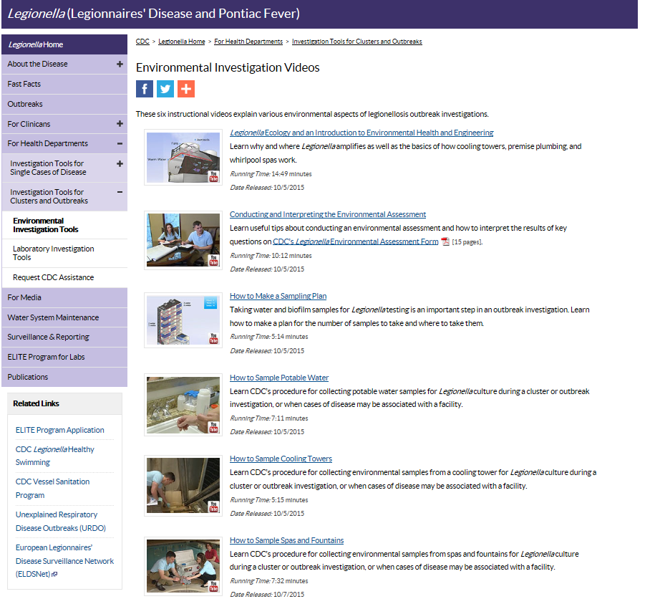
CDC Legionella Videos

