Slide 1
Microbe Identification
De-mystified

Slide 2
Classification
Group Classification Activity
What does it mean?
Begin with group that shares many common features
Prokaryotes
Viruses
Narrow groups down based upon small differences
Species and subspecies

Slide 3
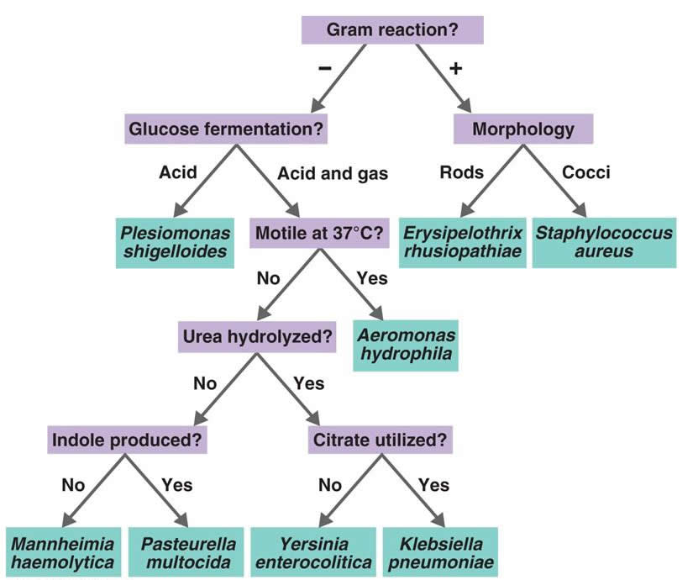
Dichotomous Key
Dichotomous Key

Slide 4
How Microbial Characteristics are Identified
Growth Characteristics
Biochemical Tests
Antibiotic Sensitivity Tests
Protein Identification (Immunology)
Nucleic Acid Identification

Slide 5
Growth Characteristics
Colonial Morphology
Growth Characteristics
Cellular Morphology
Cell characteristics
Determined through various Staining Techniques

Slide 6
Colony Characteristics
Color
Size
Margin
Elevation
Texture
Soluble Pigment
Bacteria on a plate: Wikimedia Commons

Slide 7
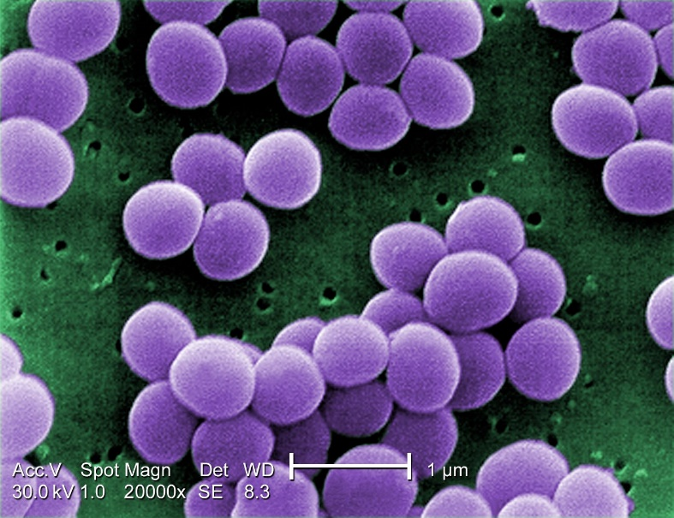
Cellular Morphology through Microscopy
Cell shape
E.coli
Staphylococcus areus

Slide 8
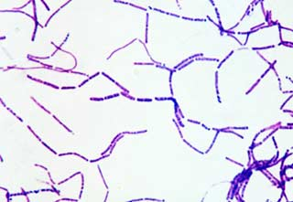
Cellular Morphology through Microscopy
Cell Grouping and size
B. subtilis
B. megaterium

Slide 9
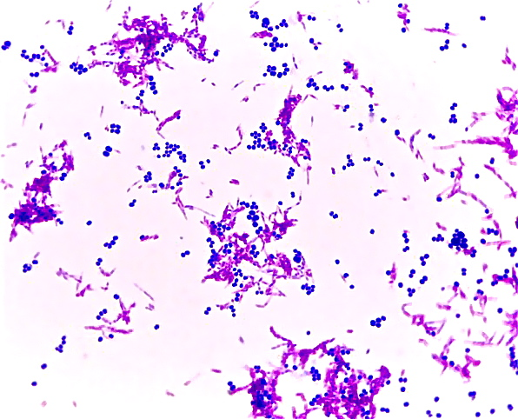
Cellular Morphology through Microscopy
Cell Wall Structure
Gram Stain
Acid Fast Stain

Slide 10
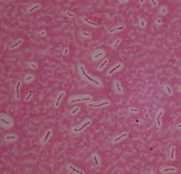
Cellular Morphology through Microscopy
Endospores
Capsules
https://commons.wikimedia.org/wiki/File:Bacillus_subtilis_endospore_stain.png
http://www.rci.rutgers.edu/~microlab/CLASSINFO/IMAGESCI/capsulestain.htm

Slide 11
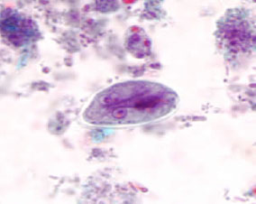
Cellular Morphology through Microscopy
Resting stage vs active growing/feeding stage
Ie. Protozoan
Giardia cyst
Giardia trophozoite

Slide 12
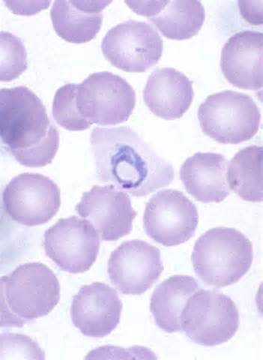
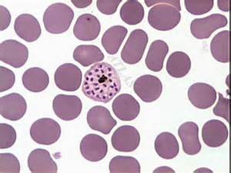
Cellular Morphology through Microscopy
Malaria
Sporozoite
Ring Stage
Schizont
(Pre-Merozoite Release)

Slide 13
Biochemical Tests
Enzymatic and fermentation abilities determined through the use of various media
Phenol Red Broth
MR/VP
SIM
MacConkey Agar
Blood Agar
Chocolate Agar
Urease
Decarboxylase
API20E
Chocolate Agar: Wikimedia Commons
Notes:
Complex Media, Blood Agar, MacConkey Agar, Phenol Red Broth, MR/VP, Enterotube

Slide 14
Antibiotic Sensitivity-Kirby Bauer Test
Media most often used: Mueller Hinton
Antibiotic infused disks
Measure diameter of zone of clearing to determine antibiotic sensitivity
Called, “Zone of Inhibition”

Slide 15
Antibiotic Sensitivity-Microdilution Method
Determines minimal concentration needed to inhibit bacterial growth
Gradual reduction in antibiotic concentration within each well
Minimal Inhibitory Concentration (MIC) determined by visual comparison between negative control and each inoculated well.
No visible turbidity indicates MIC
Microdilution Series

Slide 16
Antibiotic Sensitivity-E-Test
Antibiotic infused strip
Varying concentrations throughout length of strip.
Greatest concentration is end indicated by the letter
Several can be placed on one plate at a time.
Quick and easy but expensive
ETest

Slide 17
Protein Identification (Immunology)
Primarily consist of Antibody-Antigen Reactions
Antibody Titer dependent upon ability of the Immune System to develop “memory” of pathogens
Primary Immunological Test Used
Slide Agglutination
Direct Fluorescent Antibody Test
ELISA

Slide 18
Antibody Structure

Slide 19
Antibody Classes

Slide 20
Antibodies at Work

Slide 21
Immunological Memory and Antibody Titer

Slide 22
Slide Agglutination/Rapid Tests
Notes:
Staphytec

Slide 23
Slide Agglutination Results
Clumping

Slide 24
Lateral Flow Tests as an alternative to Slide Agglutination
Rapid Strep Test
Meningococcal Antigen Testing
Lateral Flow Strep Test
Lateral Flow Meningitis Test

Slide 25
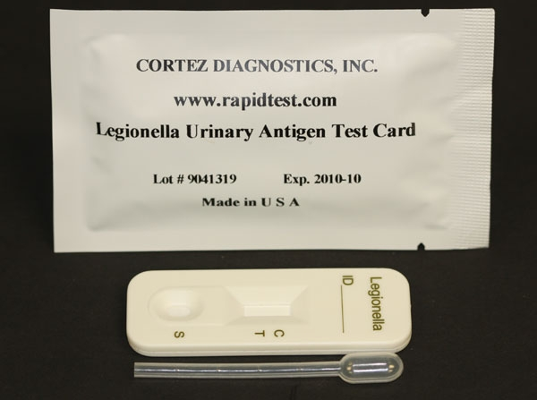
Additional Examples of Antigen Testing
Legionella Identification
Use culture method and latex agglutination in combination to diagnose
Culture performed using both charcoal yeast agar
Charcoal Yeast Agar
Urinary Antigen Test Kit

Slide 26
Direct Fluorescent Antibody
Fluorochrome tagged antibody detects antigen
https://en.wikipedia.org/wiki/Direct_fluorescent_antibody

Slide 27
ELISA (Enzyme-Linked Immunosorbent Assay)
Used to:
Determine antibody titer
Detect HIV antibodies in patient serum sample, as well as other viral infections
Thermofisher ELISA Process Overview
Source: ELISA Plate

Slide 28
Nucleic Acid Identification
DNA used to search for and identify specific microbial genes
Most commonly used technique:
PCR

Slide 29
PCR
DNA replication process to detect specific genes found in various organisms
Source: bioninja

Slide 30
Gel Electrophoresis as a Tool to view PCR Results
Gel with PCR Products
Gel Set-up

Slide 31
PCR Results
Important to note that a positive PCR result does not necessarily mean that viable cells were present.
We can only conclude that the DNA for a specific organism (gene) was present
Second View of PCR Products

Slide 32
Characteristics and Diagnosis of Specific Microbial Examples
Hepatitis B
Group A and B Streptococcus

Slide 33
Hepatitis B Virus
Click Here: Overview of Hepatitis Serology through CDC
Cleveland Clinic

Slide 34
Acute Hepatitis B Progression
Cleveland Clinic

Slide 35
Chronic Hepatitis B Progression
Cleveland Clinic

Slide 36
Interpreting Hepatitis B Results
http://dxline.info/diseases/hepatitis-virus-panel

Slide 37
Identifying and Differentiating Group A and B Streptococci
Group A Streptococcus
Group B Streptoccoccus
Streptococcus pyogenes
Can be normal flora of respiratory tract for some people (opportunistic pathogen)
Transmission: Droplet spread
Disease: Strep Throat, Scarlet Fever, Rheumatic Fever, Impetigo, Cellulitis, Toxic Shock Syndrome
Streptococcus agalactiae
Colonizes the vagina of many women
Generally does not cause disease in healthy women/becomes normal flora
Transmission: Infect newborns upon vaginal delivery
Disease: Meningitis, sepsis, or stillbirth

Slide 38
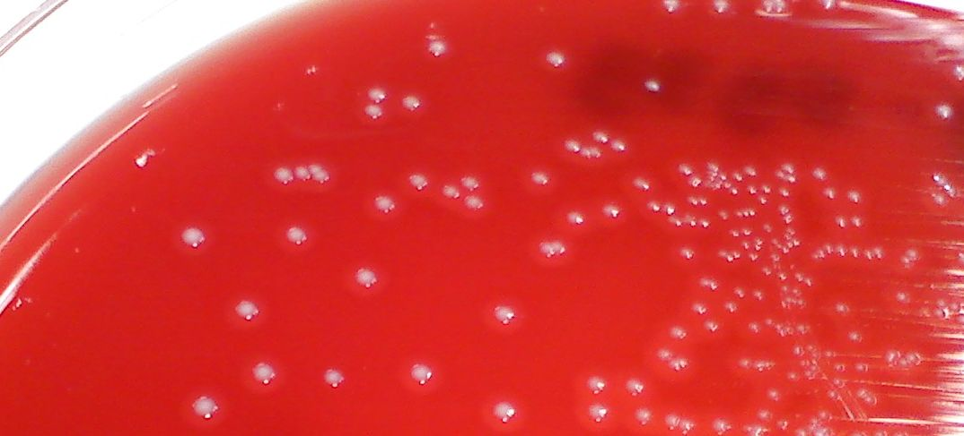
The Challenge
Similarities:
streptococci
Beta-hemolysis
Colonial morphology indistinguishable
Group A Strep
Group B Strep

Slide 39
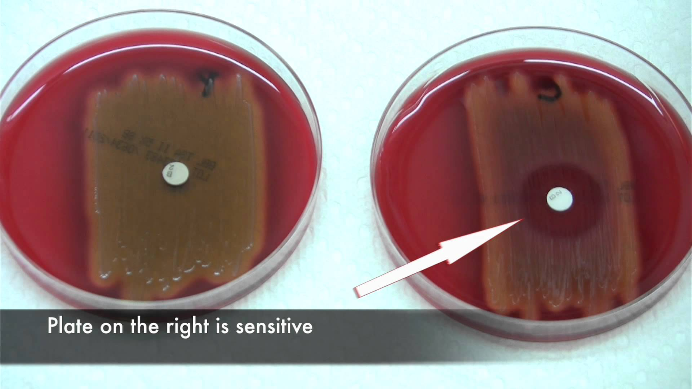
How to Differentiate Between Group A and B
Rebecca Lancefield
Developed method to determine differences between members of the genus Streptococcus
Method based upon identifying cell wall polysaccharide antigens
Streptococci grouped according to cell wall polysaccharides
Groups A, B, and D most commonly cause human disease
Diagnosis
Bacitracin sensitivity
Group B (resistant)
Group A (sensitive)
Group B
Group A

Slide 40
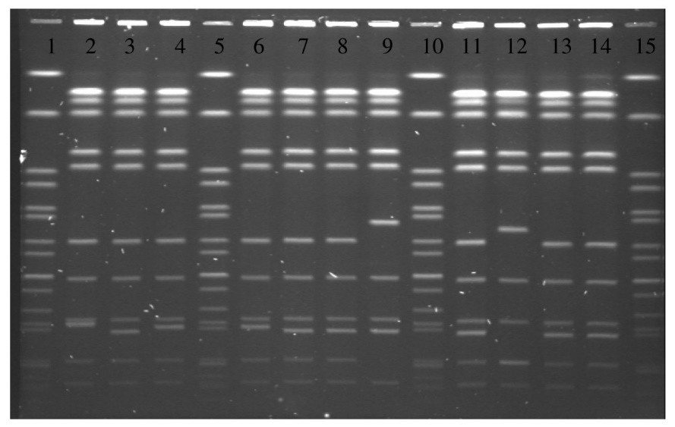
Sub-typing Strains
Salmonella
Serotyping:
Slide-agglutination flagellar antigens
PCR for specific flagellar antigens
PFGE: Pulse Field Gel Electrophoresis (DNA Finger printing)
Genetic Sequencing
PFGE
Bacterial Fingerprinting

Slide 41
Comparison between Culture, Serology, and Antigen Detection
 | Culture | Serology | DNA Antigen Detection
Attributes | Grows and maintains viable cells Basic characteristics detected Can be used to determine basic metabolic characteristics | Detects specific antigens on surface of organism Relatively inexpensive, little equipment needed Can have quick turn around | Extends the time/opportunity for detection (viable or whole organism not necessary) Extremely sensitive and effective
Limitations | Risk of contamination Limited in ability to accurately differentiate between species or sub-species | Extends time for testing False positives possible Very specific: Can only detect specific antigens pre-determined May indicate prior exposure, vaccination or current infection depending | Risk of environmental contamination leading to false positives Only detects specific organisms/genes

Slide 42
You Try It
Aches on a Plane Case Study
https://courses.cit.cornell.edu/biomi290/microscopycases/AchesPlane/aches.intro.html

