Slide 1
Infection Prevention & Control
for the Epidemiologist
Notes:
Description: In this session an epidemiologist will be able to learn more about the world of infection prevention and control.
What is an infection preventionist and why do hospitals have them? How can we make our working relationship more effective?
Questions during and at the end

Slide 2
Topics
Past, present, future
Tasks and Responsibilities
Regulatory and Accrediting Agencies
Scenarios and Investigations
Resources

Slide 3
Background
Began in 1950’s
AHA released 1st manual in 1968
CDC began NNIS in 1970
APIC was formed in 1972
HICPAC established in 1991
CDC transitioned NNIS into NHSN in 2005
Notes:
IC really began to take hold in the 1970’s: Joint Commission began specific standards
American Hospital Association
Association for Professionals in Infection Control & Epidemiology
HICPAC= The Healthcare Infection Control Practices Advisory Committee (HICPAC) federal advisory committee provides advice and guidance to (CDC) and Health and Human Services (HHS) for anything and everything related to Infection Control & Preventions in healthcare settings w/in the US.

Slide 4
Present
Infection Preventionist
  nursing, medical technology, microbiology, or public health
Report to: Administration, nursing or medical services, or quality improvement departments
Notes:
2008 – IP. aka ICP, IC nurse, officer, coordinator, nurse epidemiologist
May be involved in employee health, quality improvement, and risk management.
In nonacute care facilities, infection prevention professionals typically have multiple roles to fill and usually have only hours per week available to devote to infection prevention activities.²⁹

Slide 5
In the future…
Outsourcing specified tasks or special projects
  Increasing responsibility with reporting, pay for performance, outreach
Broader experience
Team or group based approach

Slide 6
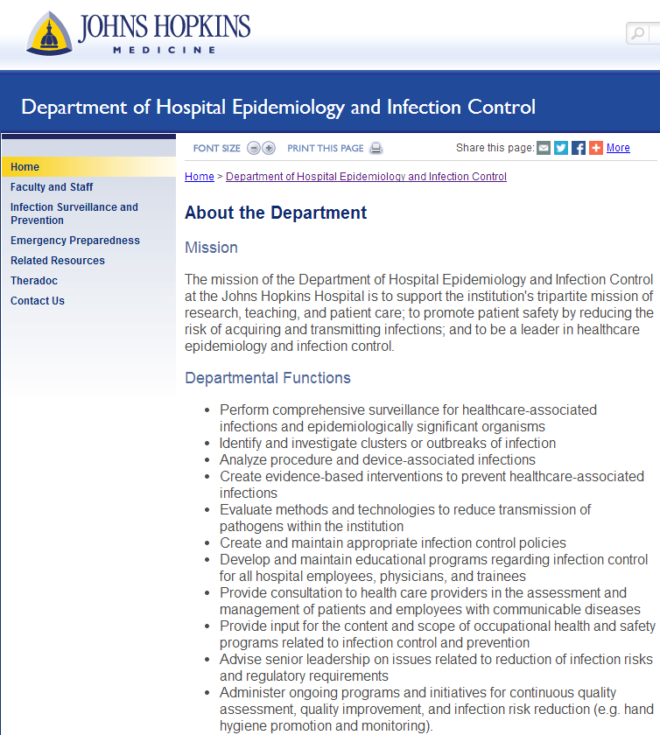
Tasks & Responsibilities
Notes:
Johns Hopkins has all of these things on their website, listing what the department does for their hospital.
- Collection and analysis of infection data
- Evaluation of products and procedures
- Development and review of policies
- Consultation on infection risk assessment, prevention, and control strategies
- Education efforts directed at interventions to reduce infection risks
- Implementation of changes mandated by regulatory, accrediting, and licensing agencies
- Application of epidemiological principles, including activities directed at improving patient outcomes
- Cost-efficient, high-quality services
- Participation in research projects
- includes activities related to occupational health, construction, and disaster planning

Slide 7
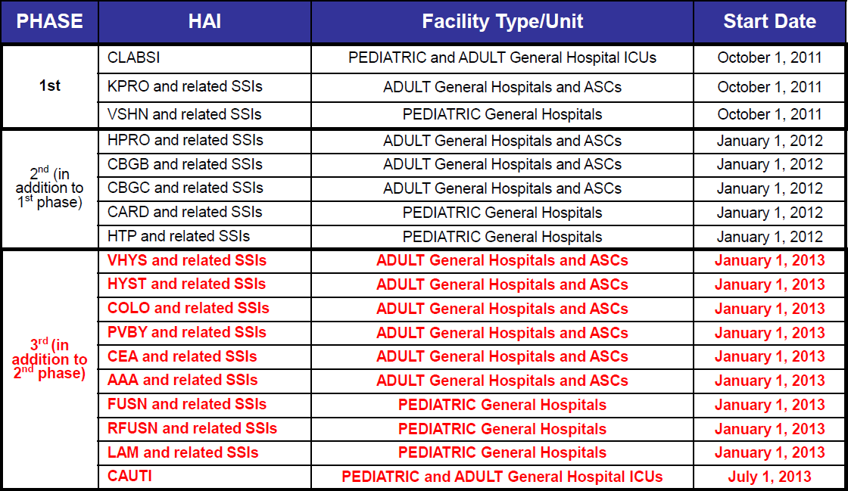
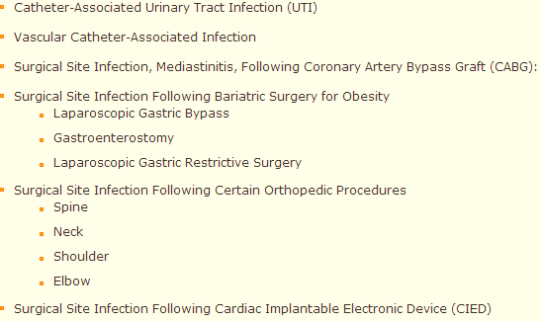
Tasks and Responsibilities
Acute Care & LTACs | CLABSI | CAUTI | SSI | MRSA | C.Diff | Flu Shots
Rehab | Flu Shots | CAUTI

Slide 8
Tasks & Responsibilities
In short…
- Survey for HAI’s, develop interventions
-ID clusters
-Policies
-Education for all
-Knowledgeable and reporting of communicable diseases
-Occupational/employee health
-Regulatory requirements
-Programs & initiatives

Slide 9
Regulatory and Accrediting Agencies
DSHS Regulatory | DADS Regulatory
The hospital shall provide a sanitary environment to avoid sources and transmission of infections and communicable diseases. There shall be an active program for the prevention, control, and surveillance of infections and communicable diseases | The facility must establish and maintain and infection control program designed to provide a safe, sanitary and comfortable environment and to help prevent the development and transmission of disease and infection
Designate a person over the program | __________________________________
Ensure policies for prevention, control and surveillance of infections and communicable diseases are developed, implemented and enforced. | Under the program, the facility must investigate, control and prevent infections in the facility
A system for identifying, reporting, investigating, and controlling HAI’s and communicable diseases between patients and personnel. | The facility must have and implement written policies for the control of communicable disease in employees and residents and must maintain evidence of compliance with local and state health codes and ordinances regarding employee and resident health status.

Slide 10
Regulatory and Accrediting Agencies
DSHS Regulatory | DADS Regulatory
Maintain a log of all reportable diseases and HAIs designated as epidemiologically significant according to the hospital's infection control policies. | Under the program, the facility must maintain a record of incidents and corrective actions related to infections
A written policy shall be adopted, implemented and enforced for reporting all reportable diseases to the local health authority | The name of any resident with a reportable disease must be reported immediately to the city health officer, county health officer, or health unit director having jurisdiction, and appropriate infection control procedures must be implemented as directed by the LHD
A system for identifying, reporting, investigating, and controlling HAI’s and communicable diseases between patients and personnel. | The facility must have and implement written policies for the control of communicable diseases in employees and residents and must maintain evidence of compliance with local and state health codes and ordinances regarding employee and resident health status.

Slide 11
Regulatory and Accrediting Agencies
DSHS Regulatory | DADS Regulatory
The IC program shall include active participation by the pharmacist | __________________________________
The CEO, the medical staff, and the CNO shall be responsible for: The hospital-wide quality assessment and performance improvement program and training programs shall address problems identified by the infection control professional. Implement successful corrective action plans in affected problem areas | The Quality Assessment and Assurance Committee will monitor the infection control program.
A policy to monitor compliance of the hospital and its personnel and medical staff with universal precautions | Universal precautions must be used in the care of all residents. Facilities are responsible for complying with OSHA regulations.
Hospital (General) Licensing State Regulations: TAC Title 25, §133.41 (subchapter C) Policies must be developed, adopted, implemented and enforced. | Nursing Facility Requirements for Licensure and Medicaid Certification Handbook, Subchapter Q, Infection Control

Slide 12
Regulatory and Accrediting Agencies
CMS
• The infection prevention and control program demonstrates ongoing surveillance, recognition, investigation and control of infections to prevent the onset and the spread of infection, to the extent possible; | • The facility demonstrates practices to reduce the spread of infection and control outbreaks through transmission-based precautions (e.g., isolation precautions);
• The facility demonstrates that it uses records of incidents to improve its infection control processes and outcomes by taking corrective action; | • The facility demonstrates practices and processes consistent with infection prevention and prevention of cross-contamination;
• The facility consistently demonstrates appropriate hand hygiene (e.g., hand washing) practices, after each direct resident contact as indicated by professional practice; | • The facility has processes and procedures to identify and prohibit employees with a communicable disease or infected skin lesions from direct contact with residents or their food, if direct contact will transmit the disease;
• The facility demonstrates handling, storage, processing and transporting of linens so as to prevent the spread of infection | LTC: https://www.cms.gov/Regulations-and-guidance/Guidance/Transmittals/downloads/r51soma.pdf

Slide 13
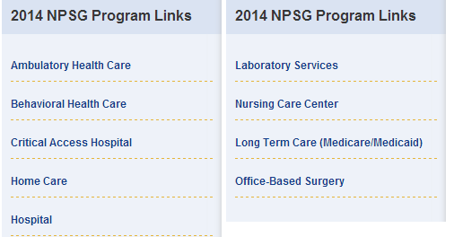
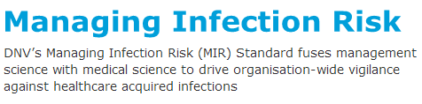
Accreditation
Notes:
The top boxes are from Joint Commission, one accrediting source that most are familiar with.
They have what are called National Patient Safety Goals. You can view the ones for hospital and specifically for Infection Control. These are updated annually.
The next is from DNV’s another accrediting source. They what is called ISO process. After a facility is accredited they can be certified in MIR. It is a one to three year process.

Slide 14
Basic IC Knowledge
Hand hygiene
Standard vs Transmission Based Precautions
Environmental Hygiene, Cleaning & Processing
Surveillance

Slide 15


Slide 16
A 2012 Online Survey…
5446 healthcare practitioners found that:
6% sometimes or always used single dose/vials on multiple patients
15% used the same syringe to re-enter multidose vials
9% sometimes or always used a common bag or bottle of intravenous solution as a source of flushes and drug diluents for multiple patients
1% reuse a syringe but change the needle for use on a 2nd patient
Notes:
Another survey of U.S. healthcare workers found that 1%-3% reused the same needle and/or syringe on multiple patients.
1% is 45 respondents. 1 of which worked in a LTCF

Slide 17
Standard Precautions
Use with all patients in the hospital
Use appropriate PPE
Remove all PPE before leaving room
  No gowns in hallways, even if cold
  Especially gloves

Slide 18
Transmission Based Precautions
Contact Precautions (Isolation)
Ex: MRSA, VRE, ESBL’s, CDIFF, and any other MDRO’s (multi drug resistant organism)
Minimum PPE to enter this room is gloves and a gown
Droplet Precautions (Isolation)
Ex: Flu, the common cold & meningitis
Minimum PPE to enter this room is a plain surgical mask
Airborne Precautions (Isolation)
Example: TB, disseminated shingles, and measles
NOTE: minimum PPE to enter this room is an N-95 respirator

Slide 19
Flu
Staff
  Flu vaccine
  Clean hands often
  Standard & Droplet
    Wear a mask
  Stay home at least 24hrs post fever
Patient
  Flu vaccine
  Clean hands often
  Wear a mask when out
  Single room vs. cohort
  Doors can be open
  2-5 days fever free
    DI for immunocompromised
Notes:
What is that persons baseline?
Masks need to be changed out frequently.
Cohort but avoid placement with high-risk patients == change gown and gloves and perform hand hygiene prior to touching the next patient.
2 days if they are housed with non-high risk, CDC outbreak recommends 5 days.

Slide 20
C. difficile
Patient
  Asymptomatic vs. symptomatic
  Soap & water
Staff
  Standard & Contact precautions
Environment
  Daily, fresh bleach 1:10
  EPA approved
  Bedside commode

Slide 21
MDRO’s
CRE
MRSA/VISA/VRSA
MDR-A
VRE
Patients at High Risk for Infection
  Frequent or prolonged hospital stays
  Prolonged antibiotic use
  Indwelling medical devices
  Chronic medical conditions
Notes:
Normal gut bacteria; causes many types of infections. Started to be seen in 1992 and then in the US in 2001
Bloodstream CRE infections have shown as high as 50% mortality
CP could be modified in these settings. Higher risk for transmission vs. those considered functional.
▪ Dependent upon HCP for their activities of daily living
▪ Ventilator-dependent
▪ Incontinent of stool
▪ Wounds with drainage that is difficult to control
For other residents (more functional), requirement for contact Precautions might be relaxed -- Emphasize hand hygiene, keep wounds covered

Slide 22
Acute & Long-Term Care Facilities CRE Interventions
Core
  Hand hygiene
  HCP education
  Minimize device use
  Patient and staff cohorting
  Lab notification
  Antimicrobial stewardship
  CRE screening
Supplemental
  Active surveillance testing
  Chlorhexidine bathing
Other Measures
  Retrospective surveillance
    6-12mos look back
  Intra and inter-facility communication of patients
Notes:
Search “CDC CRE Toolkit” and find this 28 page document
1) Educate staff with frequent in-services: NEO, annually, monitor compliance and provide feedback of performance
❑ Ensure access to hand hygiene stations, Install alcohol-based hand gel dispensers in/near patient rooms, Encourage use of alcohol-based hand gel dispensers in favor of soap and water (exceptions include when hands are visibly soiled)
2) Keep staff up-to-date on rates, tell them about CRE now and how to isolate
3) Minimize use of invasive devices
❑ Ensure implementation of HICPAC recommendations: Urinary catheters, CVCs/PICCs
4) Place CRE patients in single-patient rooms
▪ Cohort patients together in same room, specific units w/dedicated staff.
Single rooms for highest risk (e.g., incontinent, devices, open wounds)
5) Perform appropriate lab screening for CRE (in accordance with CLSI guidance)
❑ Are protocols in place for timely notification of CRE to the appropriate staff
▪ Applies to on-site and off-site laboratories
6) Ensure appropriate indications and duration of use of antimicrobial therapy
❑ Use narrowest spectrum of antimicrobial that is appropriate
7) Screening is used to ID unrecognized CRE among high-risk patients: Epi-linked cases
▪ Point prevalence surveys
• Rapid evaluation of CRE prevalence in particular wards/units
• Do once if few or no additional CRE colonized patients identified
• Do serially if colonization more widespread and/or to follow effect of intervention
Supplemental
Patients who may not be epi-links to cases, but meet certain pre-specified criteria
LTCF – bathe high-risk patients with 2% chlorhexidine

Slide 23
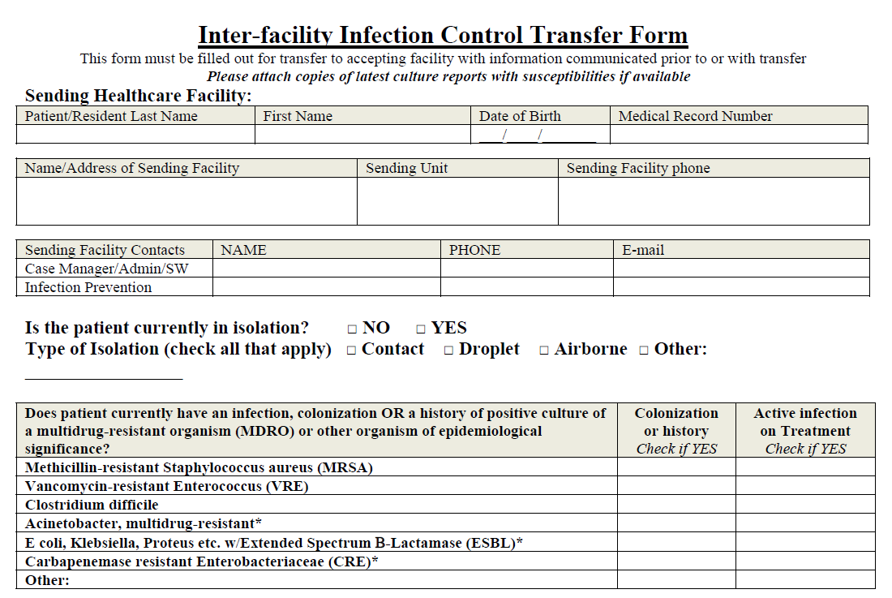

Slide 24
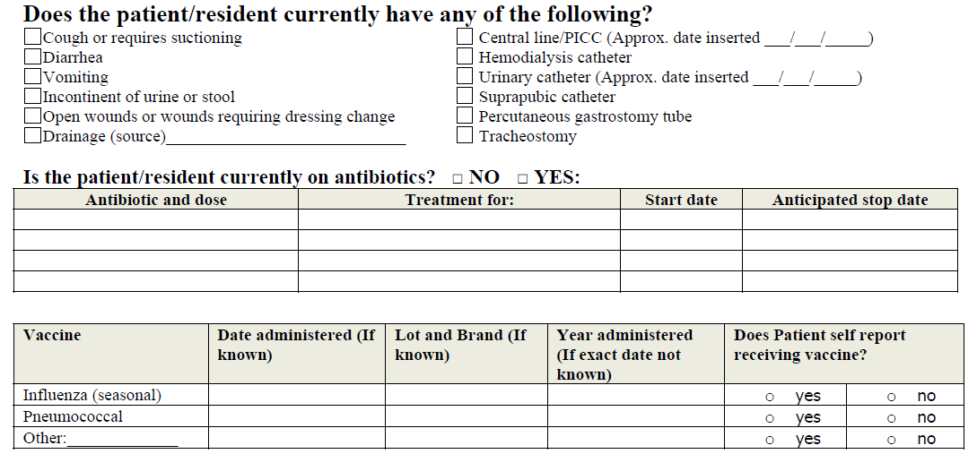

Slide 25


Slide 26
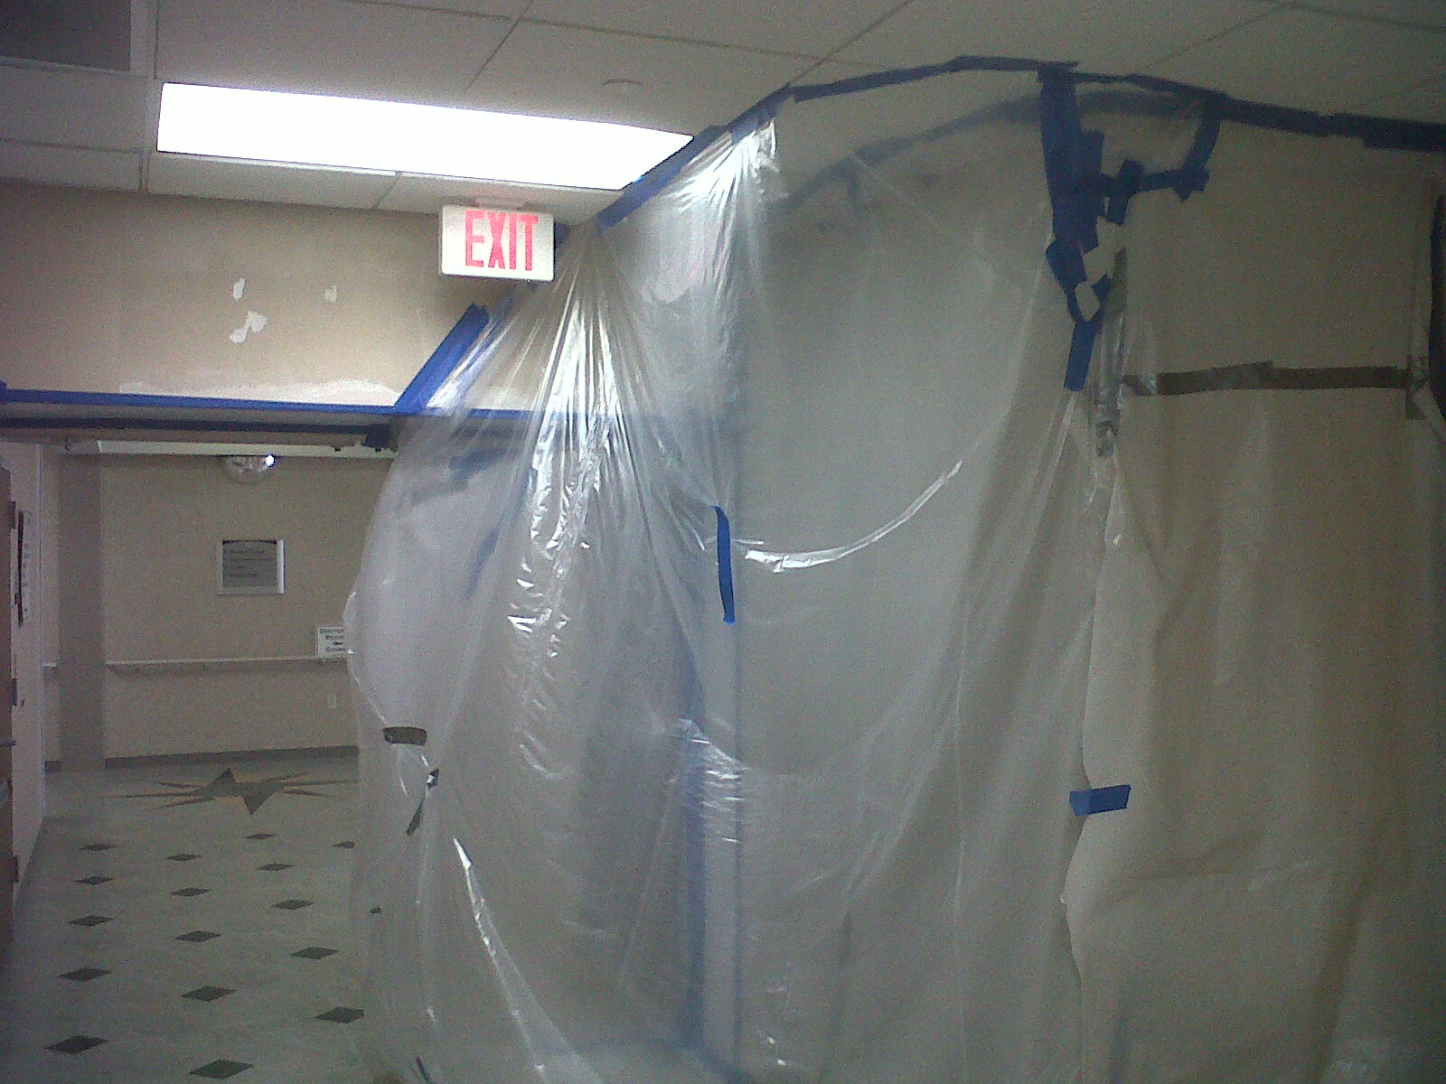
Environmental Hygiene
Notes:
Construction job that was terribly set up.
They tried!
But they forgot to ask if it met IC standards.
How would you know by looking at it if it’s good or not?
Environmental Hygiene is not only about cleaning patient rooms, but how well the whole environment is at protecting patients from infections.

Slide 27
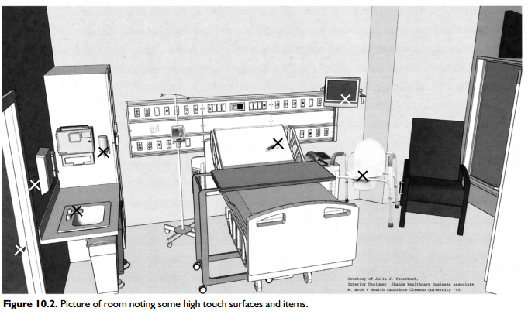
Environmental cleaning
Consider
Daily cleaning routine
Checkout / Discharge / Terminal
Who cleans items like BP cuffs, wheel chairs, IV Poles, keyboards?
How many products do you use?
Notes:
What is your daily cleaning like vs. checkout/discharge cleaning?
Do the staff clean the bed if the patient is in it?
How many products do you use? What is the right number of products? Products for C. diff or other special pathogens

Slide 28
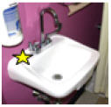
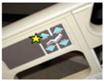
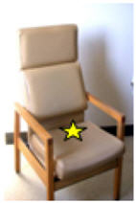
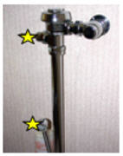

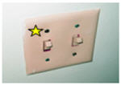
Environmental Cleaning
Staff involvement: ideas for improvement & product evaluation
Spot checks
Adequate timing
Notes:
Ask your own staff for ways to improve, let them evaluate products before switching.
Get them involved in environmental spot checks.
Are you giving them enough time to do the job you’re asking them to do.
====

Slide 29
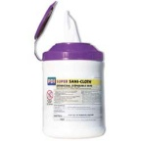
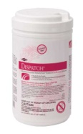
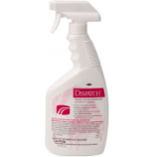
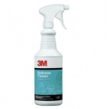
Contact Time
PDI Super Sani-Cloth
Contact time: 2 minutes
Dispatch wipes or spray
Contact times: 1 minute-most germs
2 minutes TB
5 minutes Cdiff
3M Quat #25
Contact time:10 minutes

Slide 30
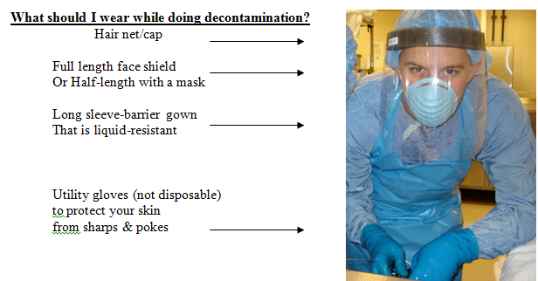
Sterile Processing
Types of machines
Tests
Materials, Products
Notes:
This topic alone can take up a whole day or weekend.
If you have an outbreak, cluster or situation related to surgical processes you really need someone knowledgeable in the area or at least someone who knows where to go to find the standards that should be met so they can help figure out where practices aren’t being met.

Slide 31
Putting it all together…surveillance
Upfront of process
Notice of follow-up
Share documents that you are using
Asking for their preferences
Notes:
Now that you know a little more about what an IP does when they’re not reporting communicable diseases to you, how can you all work together to help each do your jobs faster?
You have your surveillance and cases to get taken care of, no need to stretch it out.

Slide 32
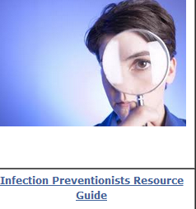
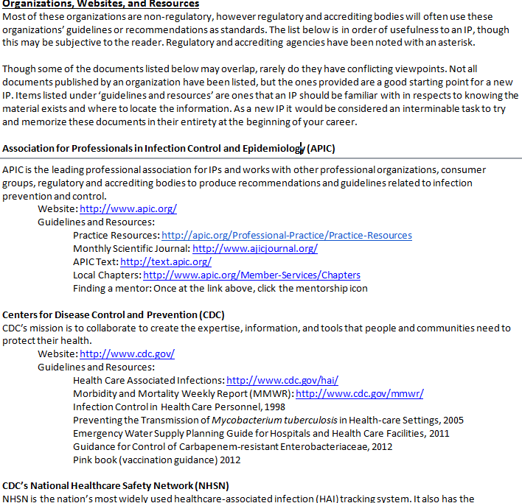
Resources
IDCU.org
Notes:
Our website provides a Word Document, it’s a resource list for newer IPs with notes about regulatory and accrediting agencies.
- You are not training to be a surveyor or an IP but you should be knowledgeable in what you’re looking at.

Slide 33
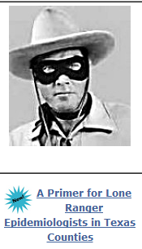
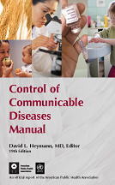


Notes:
Primer: made by our own lone ranger epi
Control of communicable diseases: good book to recommend to a new IP or yourself
Red book: childhood disease
Pink book: VPD’s

Slide 34
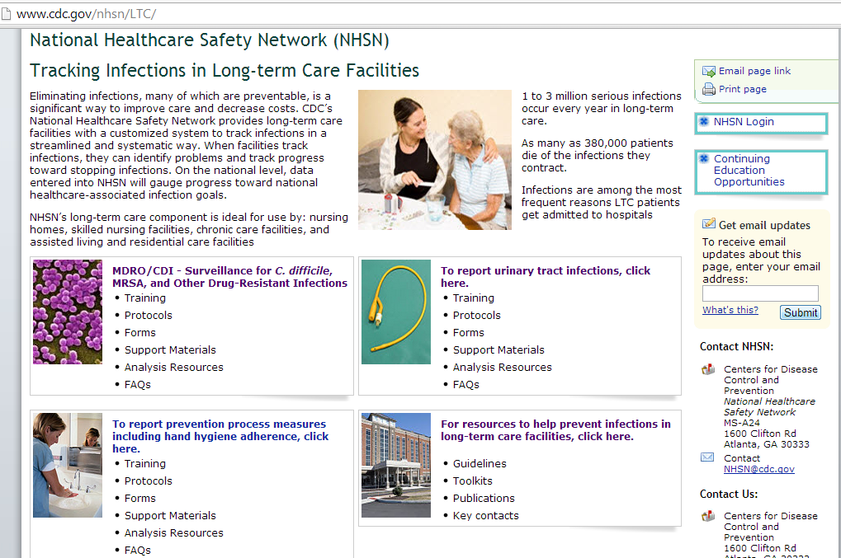
Quality Assessment and Performance Improvement
Symptomatic UTI’s
Symptomatic CAUTI’s
Catheter utilization
Health Care Personnel Influenza Vaccination
C. difficile Infection
Notes:
How many have heard of NHSN?
In 2012, a LTCF component was released. AHRQ is coordinating the development of the Common Formats, which standardize the definitions and reporting formats for patient safety events
Acute care facilities have been using it for a long time, but now nursing homes can as well….
They should already be using what’s called McGreer Definitions, then they can compare their rates to other nursing homes if they’re all using the same definitions for numerators.
NHSN has the ability for nursing homes to track their rates for the following areas (listed on screen)

Slide 35
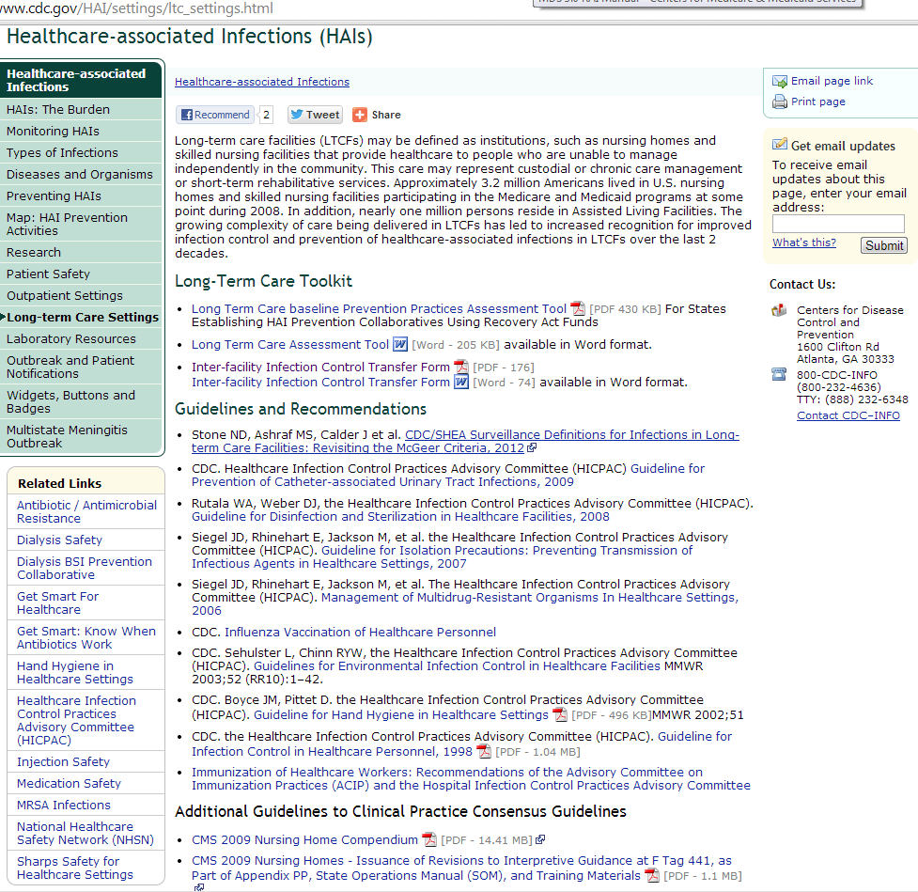
Resources for Long-term care
Notes:
These are additional resources for long term care places.
The text is tiny so cdc.gov/HAI/settings/ltc_settings.html

Slide 36
Situations, Questions, Oddities
This one time….

