Slide 1
Department of Aging and Disability Services
Neil Pascoe RN BSN CIC
Epidemiologist
Emerging and Infectious Disease Branch
Infectious Disease Control Unit
ELC Epi Workshop March 5, 2014

Slide 2
www.agencyabreviation.state.tx.us (www.dshs.state.tx.us)

Slide 3
DSHS Regulates
Abortion Facilities
Ambulatory Surgical Centers
Birthing Centers
Community Mental Health Centers
Comprehensive Out-Patient Rehabilitation Facilities
End Stage Renal Disease Facilities
Freestanding Emergency Medical Care Facilities
Hospitals - General
Hospitals - Psychiatric & Crisis Stabilization Units
Hospitals - Special
Laboratories - (CLIA)
Narcotic Treatment Clinics
Out-Patient Physical Therapy or Speech Pathology Services
Portable X-Ray Services
Rural Health Clinics
Special Care Facilities
Substance Abuse

Slide 4
DADS Regulates one
Adult Foster Care
Assisted Living Facilities
Home and Community-based Services
Primary Home Care
Hospice
Intermediate Care Facilities
Nursing Homes
Residential Care
State Supported Living Centers

Slide 5
DADS Regulates two
Area agencies on aging
Area agencies on aging transportation
Community Attendant Services
Community Based Alternatives
Community Living Assistance and Support Services
Consumer Directed Services
Consumer Managed Personal Assistance Services
Day Activity and Health Services
Deaf Blind with Multiple Disabilities
Emergency Response Services
Family Care
Guardianship Program
Home Delivered Meals
In-Home and Family Support
Local authorities
Medically Dependent Children Program
Pre-admission Screening and Resident Review
Program of All-Inclusive Care for the Elderly
Promoting Independence
Special Services to Persons with Disabilities
Special Services to Persons with Disabilities 24-Hour Shared Attendant Care
Texas Home Living

Slide 6
Similarities between DSHS and DADS
Both license multiple facility types
Both have a regulatory function
Both receive state and federal funds to operate
Both advocate for healthy Texans
Both require licensed facilities to report notifiable conditions.

Slide 7
Resident’s Rights
People moving into a LTCF become “residents”
Resident’s receiving care in a LTC facility are essentially at home

Slide 8
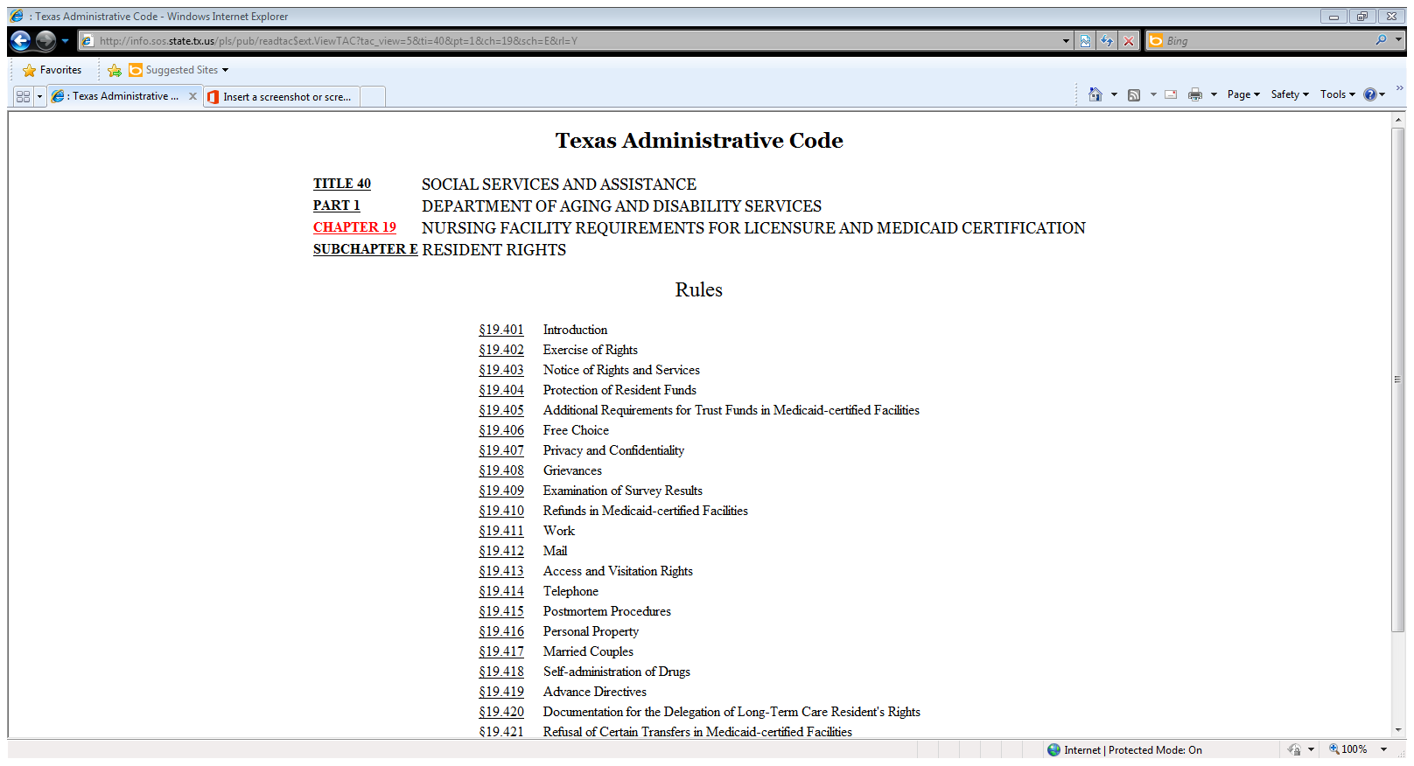

Slide 9
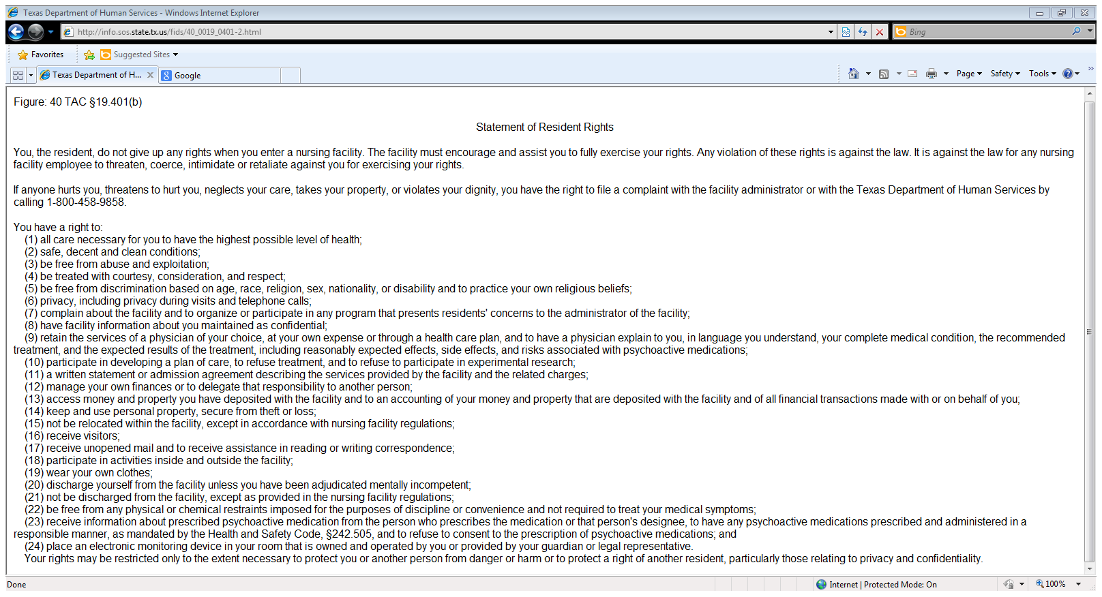

Slide 10
DADS IC Regulatory Enforcement
Federal 42 CFR §483.65 (F441)
Combines F441, 442, 443, 444 and 445
State 40 TAC Part 1 Chapter 19 subchapter Q
19.601 addresses IC requirements
Both require facilities to establish and maintain an IC program designed to provide a safe, sanitary, and comfortable environment to prevent the introduction and transmission of disease

Slide 11
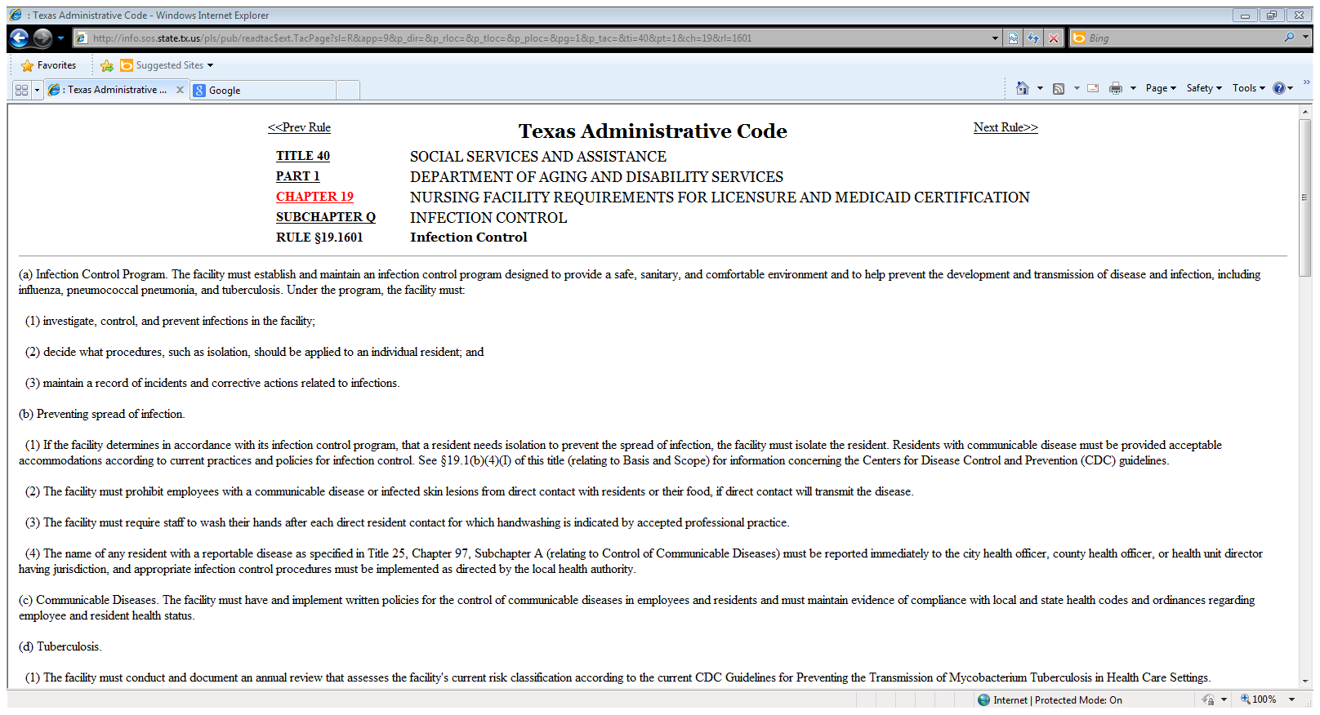
http://info.sos.state.tx.us/pls/pub/readtac$ext.ViewTAC?tac_view=4&ti=40&pt=1&ch=19

Slide 12
Provider Letters
09-18 SHEA/APIC Recommendations for IC in LTCF
12-17 vaccines for residents
13-03 vaccines for HCW
http://www.dads.state.tx.us/providers/communications/letters.cfm
DADS TRAINING
http://www.dads.state.tx.us/providers/Training/jointtraining.cfm

Slide 13
Is it bigger than a bread box?

Slide 15
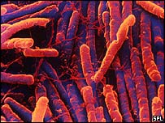
Clostridium Difficile
Discovered in 1935 by Hall & O’Toole.
Ubiquitous anaerobic gram-positive spore
forming bacillus.
Causes 20-30% of all antibiotic associated diarrhea
Named “difficult clostridium” due to its resistance in isolation and growth.
In 1978 C. difficile produced toxin was found in patients with antibiotic-associated pseudomembranous colitis. Not all strains toxigenic.
Normally found in ~ 3% adults and 15-60% children < 1 yo, 10% to 20% of hospitalized patients
Rate and severity of C. difficile-associated diarrhea (CDI) increasing
New strain of C.difficile with increased resistance and virulence identified.
LaMont, 2006

Slide 16
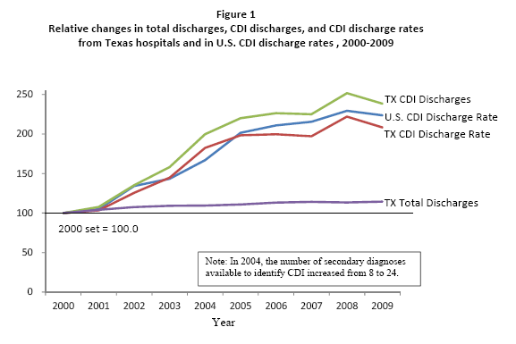

Slide 17
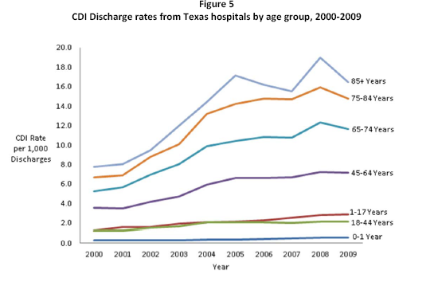

Slide 18
Prevention Strategies: Core
Contact Precautions for duration of diarrhea
Hand hygiene in compliance with CDC/WHO
Cleaning and disinfection of equipment and environment
Laboratory-based alert system for immediate notification of positive test results
Educate about CDI: HCP, housekeeping, administration, patients, families
http://www.cdc.gov/ncidod/dhqp/id_CdiffFAQ_HCP.html
Dubberke et al. Infect Control Hosp Epidemiol 2008;29:S81-92.

Slide 19
Prevention Strategies: Supplemental
Extend use of Contact Precautions beyond duration of diarrhea (e.g., 48 hours)*
Presumptive isolation for symptomatic patients pending confirmation of CDI
Evaluate and optimize testing for CDI
Implement soap and water for hand hygiene before exiting room of a patient with CDI
Implement universal glove use on units with high CDI rates*
Use sporicidal disinfectant – containing agents for environmental cleaning
Implement an antimicrobial stewardship program
* Not included in CDC/HICPAC 2007 Guideline for Isolation Precautions

Slide 20
Outline of a C. difficile “Bundle of Bundles”
Prompt identification and isolation of cases
at first suspicion
Laboratory testing
Hand hygiene
Environmental cleaning
Antimicrobial stewardship
Surveillance
Visitors
???

Slide 21
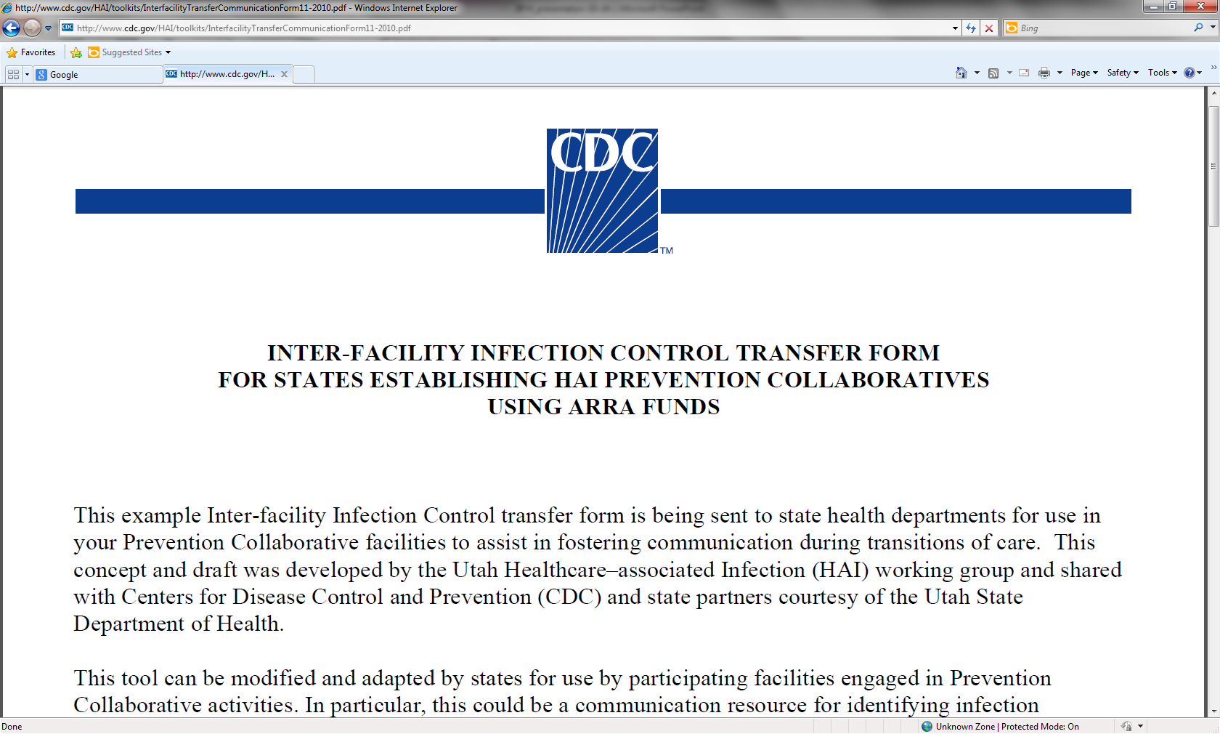
http://www.cdc.gov/HAI/toolkits/InterfacilityTransferCommunicationForm11-2010.pdf

Slide 22
http://texasqio.tmf.org

Slide 23
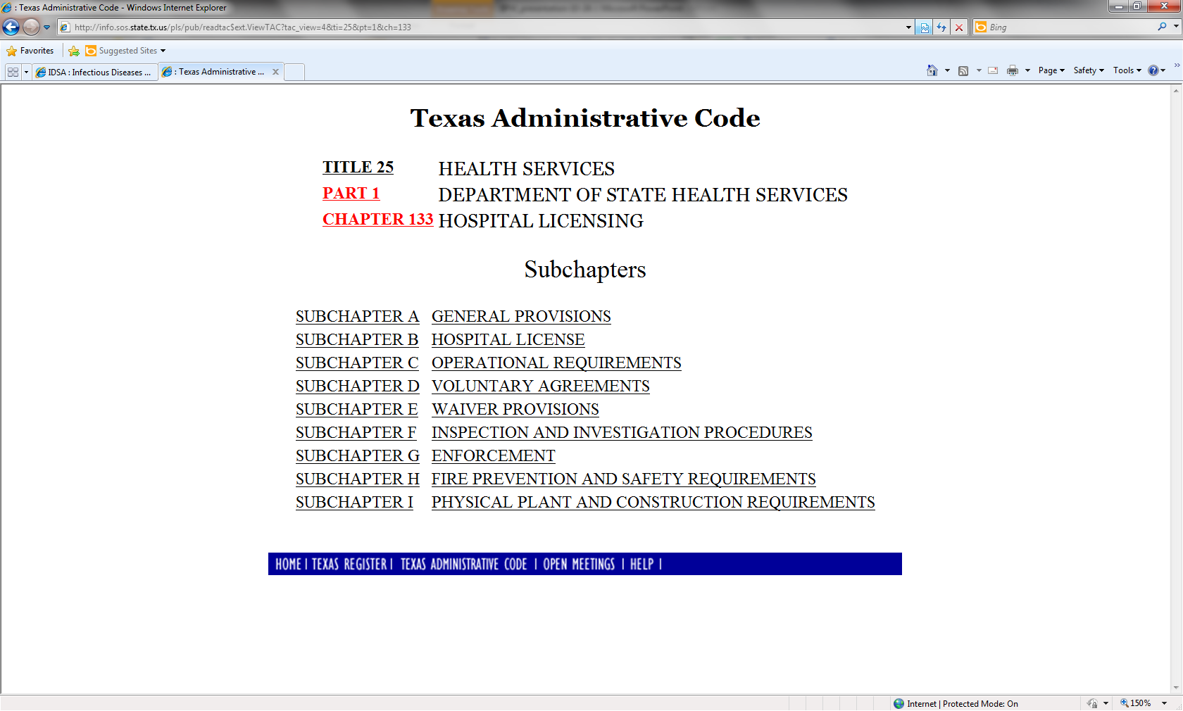
DSHS Regulations
http://info.sos.state.tx.us/pls/pub/readtac$ext.ViewTAC?tac_view=4&ti=25&pt=1&ch=133
http://www.dshs.state.tx.us/hfp/
Every Facility type has their own set of rules.

Slide 24
DADS Regulations

Slide 25
Resources
http://www.dads.state.tx.us/news_info/publications/handbooks/index.html#handbooks
http://www.dads.state.tx.us/qualitymatters/qcp/infectioncontrol/index.html
http://www.dshs.state.tx.us/idcu/
http://www.cdc.gov/HAI/settings/ltc_settings.html

Slide 26
Resources continued
http://www.vdh.virginia.gov/epidemiology/surveillance/hai/longterm.htm
http://www.medicare.gov/nursinghomecompare/search.html
http://www.jstor.org/stable/10.1086/667743 (McGeer Surv.)
http://www.jstor.org/stable/10.1086/592416 (SHEA LTC guide)
http://www.apic.org/Search/Index?Keywords=LTCF
http://www.ahrq.gov/professionals/systems/long-term-care/index.html

Slide 27
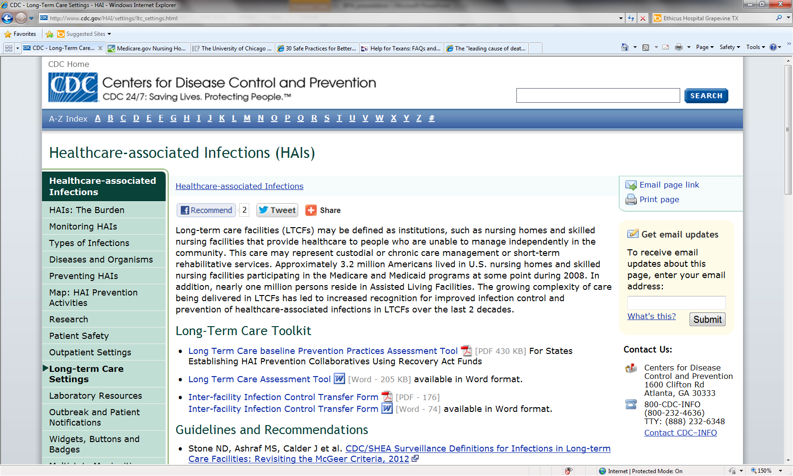

Slide 28
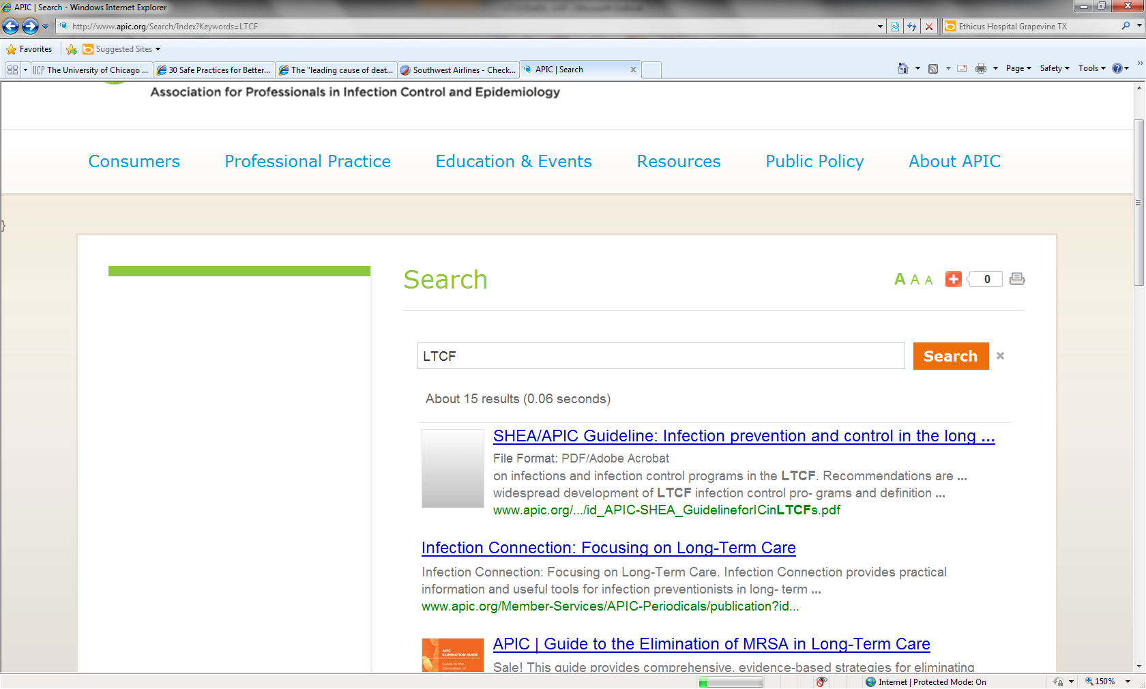
http://www.apic.org/Search/Index?Keywords=LTCF

